Slide 1
The Least Dangerous Assumption Revisited: Raising Expectations for the Certificate of Completion
Indiana State University
Department of Educational Leadership
Law and Leadership Conference
February 28, 2018
Notes:
Thank you for being here today. I have been at the Dept. of Ed for 3 years now and most of that time we have been focusing on improving outcomes for all students, but particularly those with disabilities. In doing so, we have found ourselves revisiting and the notion of the Least Dangerous Assumption first coined in 1984 by Ann Donnellan, a special education researcher most recently from the University of San Diego, Dept. Of Teaching and Learning.

Slide 2
The Least Dangerous Assumption
“In the absence of conclusive data, educational decisions ought to be based on assumptions which, if incorrect, will have the least dangerous effect on the likelihood that students will be able to function independently as adults…”
Anne M. Donnellan, 1984
”
Notes:
For those of you who are not familiar with this work, or subsequent research of Rossetti and Tashi, in 2002, and Carol Jorgenson in 2005, the lease dangerous assumption asserts that ….. (READ)

Slide 3
The Least Dangerous Assumption
“Thus…the least-dangerous assumption when working with students with significant disabilities is to assume that they are competent and able to learn…”
“To do otherwise would result in harm…such as fewer educational opportunities, inferior literacy instruction, a segregated education, and fewer choices as an adult.”
-Cheryl Jorgensen, Ph.D. 2005
Notes:
READ… Today I will be sharing information about some significant changes in requirements for students who have been removed from the diploma path to a Certificate of Completion Path. The concept of the Least Dangerous Assumption clearly informed and guided all of this work.

Slide 4
BACKGROUND/CONTEXT
511 IAC 7-43-4(h) requires that the IEP of a student entering grade 9 or becoming 14 years of age must contain documentation regarding whether the student will pursue a high school diploma, as defined in 511 IAC 6-7.1-1(e), or a certificate of completion.
The term “certificate of completion” is not further defined, but is interpreted to be a document awarded to a special education student who has been taken off of the diploma path but completes the public school educational program prescribed in the student’s IEP.
Notes:
As you know, Article 7, our state special education law, requires the Individual Education Program of a student entering 9th grade or becoming 14 years of age to contain documentation regarding whether the student will pursue a high school diploma or a certificate of completion. This is a decision that should be revisited each year that the student is in high school. It is NOT a decision that should be made earlier in a students academic career. (Read last paragraph)
The Certificate of completion may only be awarded to a student with a disability who has completed the special education program outlined in the student’s IEP.

Slide 5
Statewide Public and Private Enrollment K – 12+ | 2014-15 | 2015-16 | 2016-17 | 2017-18
Total Student Enrollment | 1,110,188 | 1,108,778 | 1,110,283 | 1,114,271
Number of school-aged students receiving special education services | 158,262 | 159,201 | 161,136 | 162,806
Percent of students receiving special education services | 14.26% | 14.36% | 14.51% | 14.61%
Notes:
We are responsible for serving 161,136 students or 14% or our overall pre-k through 12 public and private school enrollment

Slide 6
EXIT DATA
 | 2016 | 2017
Total SWD who exited | 8102 | 8207
Total SWD who exited with Certificate of Completion | 1326 | 1394
Percentage of SWD who exited with COC | 16% | 17%
Notes:
Up from 11% in 2015

Slide 7
Notes:
And as you can see from this slide, students from all disability categories were awarded the certificate of completion instead of a high school diploma.

Slide 8
IMPETUS FOR CHANGE
2014 - Indiana’s Alternate Assessment shifted focus
2015 - Vocational Rehabilitation and Workforce Development Partners expressed concerns
2015 - Parents expressed concerns about readiness for and access to the workforce
2015 - Schools report receiving minimal guidance on serving students on a COC path
2015 – Guidance from USED/OSEP clarified the definition of a FAPE
2015 - Every Student Succeeds Act (ESSA) requires equity and access for all students.
May 2016 – The number of SWD exiting high school with a COC increases from 11% to 16%
Notes:
(Read above) VR concerns about inability to place students in the workforce/no skills/COC was virtually meaningless.

Slide 9
CERTIFICATE OF COMPLETION WORKGROUP
The Certificate of Completion Work Group, a subset of the Interagency Transition Council, began meeting monthly in September 2015 to examine the issues related to the Certificate raised by schools, parents, students and the community and to develop a plan to address the issues.
The group is comprised of representatives from Vocational Rehabilitation, Workforce Development, FSSA, ARC of Indiana, ICASE, INSOURCE, Indiana Resource Network, the Indiana Manufacturers Association and various members of the Dept. of Education.
Notes:
Steve
The Certificate of Completion Work Group began meeting monthly in September 2015 to examine the issues related to the Certificate raised by schools, parents, students and the community and to develop a plan to address the issues.
The group is comprised of representatives from Vocational Rehabilitation, Workforce Development, FSSA, ARC of Indiana, ICASE, INSOURCE, Indiana Resource Network, the Indiana Manufacturers Association and various members of the Dept. of Education.

Slide 10
CERTIFICATE OF COMPLETION WORKGROUP
Goal: Address stakeholder concerns about the COC path
Academic instruction decreases
Expectations are lowered
Job possibilities are reduced
No guidance provided to schools
Holds little value or meaning for schools, employers, parents and most importantly, students.

Slide 11
POSITION STATEMENT: Diploma First
The majority of students with disabilities are capable of earning a high school diploma if given appropriate instruction, supports and services. However…
Notes:
So before even beginning this work we developed a position statement that reiterated our belief as a department that majority of students with disabilities are capable of earning a high school diploma so we must always begin with the Diploma first.

Slide 12
POSITION STATEMENT: Diploma First
Students who have been removed from the diploma track must be presented with a path that adopts the least dangerous assumption…
Where high expectations are the norm
Where academic instruction is aligned with grade level standards
Where opportunities to gain employability skills are maximized..

Slide 13
COC TASKFORCE AGREEMENT:
A Certificate of Completion Course of Study needs to be developed that meets ESSA and Dear Colleague guidance and provides pathways to student employment or post-secondary education.
Notes:
*Task force AGREEMENT
If not a diploma, then then A Certificate of Completion Course of Study needs to be developed that meets ESSA and Dear Colleague guidance and provides pathways to student employment or post-secondary education.

Slide 14
DEVELOPMENT OF COC COURSE OF STUDY
Mirrors general diploma in requirements (Minimum 40 applied units and/or credits with emphasis on academics)
Employability Skills are an integral part of the plan
Includes a Transition Portfolio
Can be earned through any combination of applied units and credits
Aligned with Statewide Assessment (ISTAR or ISTEP)
Notes:
We worked with OUR STAKEHOLDERS to assist us in developing the course of study for the certificate of completion. We have revised it several times based on extended stakeholder feedback from teachers and administrators.
Mirrors general diploma in requirements (Minimum 40 units or credits with emphasis on academics)
Employability Skills are an integral part of the plan
Includes a Transition Portfolio
Can be earned through any combination of applied units and credits
Aligned with Statewide Assessment (ISTAR or ISTEP)

Slide 15
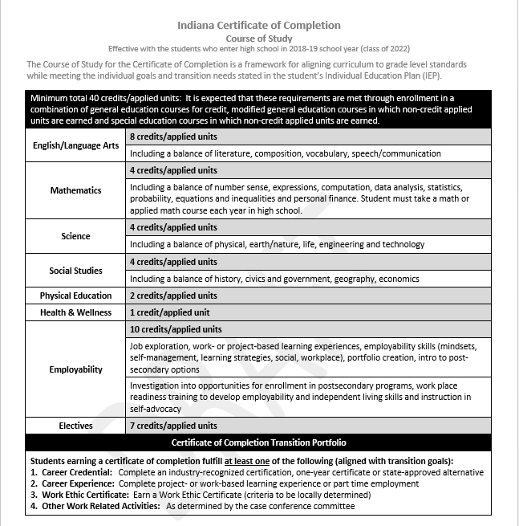
Notes:
The Certificate of Completion Course of Study will take effect with those students who enter high school in the 2018-19 school year or the class of 2022. (Review this)
(Discuss Units and Credits)
Coursed have been developed based on the alternate achievement standards or the connect connectors. Each and every student should be working toward grade level standards based on their particular, individual circumstances. That means that each and every student who has been taken off of the diploma track should be able to earn a certificate of completion, given appropriate supports and services.

Slide 16
COC ASSUMPTIONS
Each and Every Students is capable of learning
Holding students to high expectations is a shared responsibility
General Education classes are accessed whenever appropriate
Student’s IEP goals are aligned with grade level content standards that drive the curriculum
Notes:
Certificate of Completion Assumptions:

Slide 17
COC ASSUMPTIONS
Communication skills, reading skills, problem solving skills are woven into all classes
Classes may be repeated based on new goals if appropriate; more than four years may be needed for completion
Course selection is driven by the Transition IEP and individual goals of students
Life Skills can be incorporated throughout the day but is not a stand alone course.
Notes:
More Certificate of Completion Assumptions:

Slide 18
The Least Dangerous Assumption: Each and Every Student Can Learn
Students begin where they are, and move toward the grade level standard/alternate achievement standard
There is no floor/At no point is there a student who is unable to earn a Certificate of Completion

Slide 19
Operationalizing the Work: Course Descriptions
Reviewed existing Course Descriptions and developed “Applied” Versions earning units instead of credits.
Aligned to Academic Standards or Content Connectors and cross walked with Workforce Development Workplace Essentials
Worked with Curriculum Staff to ensure alignment with credit based courses.
Notes:
So how do we operationalize this work?

Slide 20
Applied Courses and Units
Notes:
The Indiana Course Descriptions were used to begin the process of developing courses that would meet the unit requirement of the certificate of completion. The related content connectors (alternate achievement standards assessed on ISTAR) and workplace essentials (skills assessed by DWD) were aligned.

Slide 21
Operationalizing the Work: Aligning Instruction
Aligned to Course Descriptions, Academic Standards, including Alternate Achievement Standards (Content Connectors)
Includes content, practice and application
Includes exposure to grade level content standards
Includes workplace essentials, employment soft skills and work experiences.
Notes:
These applied courses are aligned to General Education Course Descriptions and academic standards. They include content, practice and application and exposure to grade level content standards and also include workplace essentials, employment soft skills training and job experiences.

Slide 22
Plan Examples
Notes:
Recognizing that students earning a certificate of completion will do so in a variety of ways, we are developing sample plans. The plans will highlight a combination of credits and units and multiple courses for employability/and the transition portfolio requirements. Examples will include at least the following scenarios:
Student with most significant needs earning certificate of completion
Student earning certificate of completion in six years
Student earning certificate of completion in four years
Student who transitioned from diploma to certificate of completion after beginning high school

Slide 23
Operationalizing the Work: State Reporting/ Transcripts/SIS
Worked with State Reporting Specialists to revise all DOE reporting features to include the collection of COC data
Transcript committee revised transcript requirements
School Information System (SIS) vendors were notified and implemented changes
Notes:
SIS = Student Information Systems

Slide 24
Operationalizing the work: Implementation Plans
Beginning with the 2018-19 Cohort; Course of Study implementation begins
Reporting required beginning in 2019-20
Project Success providing regional trainings to teachers

Slide 25
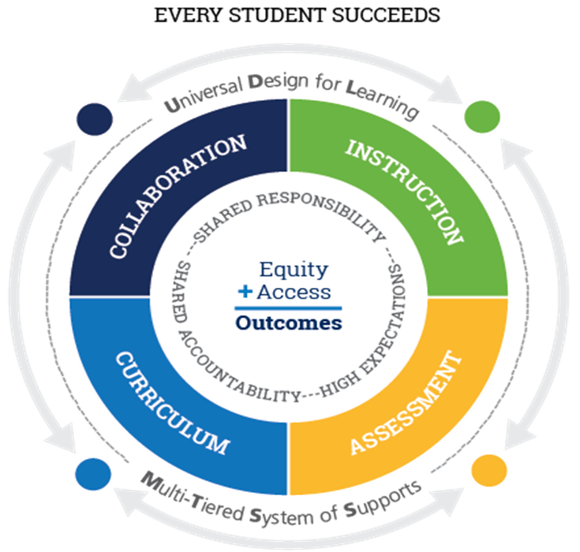
ESSA ALIGNMENT
Assessment and Standards
Supporting All Students
Supporting Excellent Educators
Accountability
School Improvement
Notes:
PAM: One of the Questions I often receive is: Does this Certificate of Completion course of study meet the requirements of the Every Student Succeeds Act. And the answer is a resounding YES! The Course of Study meets the assessment and standards requirement by providing a structure for schools that allows students to make progress toward either the Academic Standards or Alternate Achievement Standards or as we call them in Indiana, Content Connectors. The Alternate Standards are assessed using ISTAR which is Indiana’s alternate assessment…the revised requirements for earning a Certificate of Completion, promotes equity by providing a course of study that mirrors a diploma. It allows access to the general education curriculum by providing flexibility in earning either credits or units in general or special education classes. And so it meets the Supporting All Students requirement in ESSA…Supporting Excellent Educators – the Certificate of Completion, as revised, requires a more rigorous curriculum for students who have been
removed from the diploma track. Professional Development is available to all teachers who are working with students who are not on a diploma track,
particularly those who have significant cognitive disabilities…. As far as accountability goes, the Certificate of Completion, as revised, meets the requirements of an Alternate Diploma for students with significant cognitive disabilities. Although Indiana has not adopted an alternate diploma for students with significant cognitive disabilities, this certificate as re-defined, could serve in this capacity.
Finally, as DOE works with districts on school improvement, all subgroups must be considered. The Certificate of Completion, as revised, raises expectations for all students who have been removed from the diploma track. Many of these students still must be assessed using ISTEP and as we all know, raised expectations = Improved Outcomes.

Slide 26
Next Steps
Continue with extensive PD/TA
Revision of the Summary of Performance
Define Portfolio requirement
Plan ways to inform employment community
Other activities to be determined by stakeholders

Slide 27
HB 1426 – Education Matters
Establishes one standard Indiana diploma
Amended to include an Alternate Diploma for students with significant cognitive disabilities
Caps the Alternate Diploma at 1% of the cohort
Notes:
The COC requirements will meet the ESSA requirements for an Alternate Diploma.

Slide 28
The Least Dangerous Assumption
I believe my students can. Can understand Can learn Can achieve Can beat the odds Can surpass plateaus Can communicate Can reach for the stars…and grab them.
Notes:
When Kate Ahern, an assistive technology specialist and teacher of students with significant disabilities came to the inevitable bumps in the road that teachers face, she said she would review her own belief statements about teaching. This would help her get back on track.
I hope this assumption becomes the norm in our schools and that assuming competence takes the place of assuming incompetence. The changes to the certificate of completion is really just the beginning.

Slide 29
Resources
COC Webpage:
https://www.doe.in.gov/student-services/student-assistance/coc
Contact information: Pamela Wright, Ed.D.
pwright@doe.in.gov
317-232-6622

