Slide 1
Culminating Experience in Multidisciplinary Studies
Candace Marie Kendall

Slide 2
Everything happens for a reason, and a purpose, and it serves you.
Anthony Robbins
My passion is to serve my community and my purpose is to give back knowledge that once could not be received.

Slide 3
My Passion and The Fuel
Bio-Medical Sciences
A combination of Biology, Health and Medicine
Working collaboratively to diagnose disease and develop diagnostic tools and therapeutic strategies
Versatile study which serves as an excellent background for professional degrees and occupations

Slide 4
Indiana State University
Notes:
This is a photo that views the front of Holmstedt Hall where the Criminology Department is located on the second floor. During my time in high school research showed that ISU has a great Criminology program with dedicated faculty members whom are willing to guide students in the right directions. During my time here at ISU I have created a great professional relationship with all of my professors, especially Mr. Travis Behem whom worked with me directly in building the appropriate courses in regards to my minor.

Slide 5
Crime Scene Investigations
Knowledge Requirements?
What is a Crime Scene Investigator?
Responsibilities of a Crime Scene Investigator?
An individual who performs a multi-faceted approach when it comes to investigating the scene of criminal activity
Collect, preserve, package, transport and document physical evidence left at a crime scene where a suspicious act has occurred.
2-4 year college degree
Professional certification in the field
Other training will be provided

Slide 6
Terre Haute Police Department
Notes:
Lt. Stan Crime Scene Unit

Slide 7
Biology
Rigor Mortis
Chemistry
Decomposition
Anthropology
Skeletal Remains
Notes:
Talk about how cases I take relate and go to slide.

Slide 8
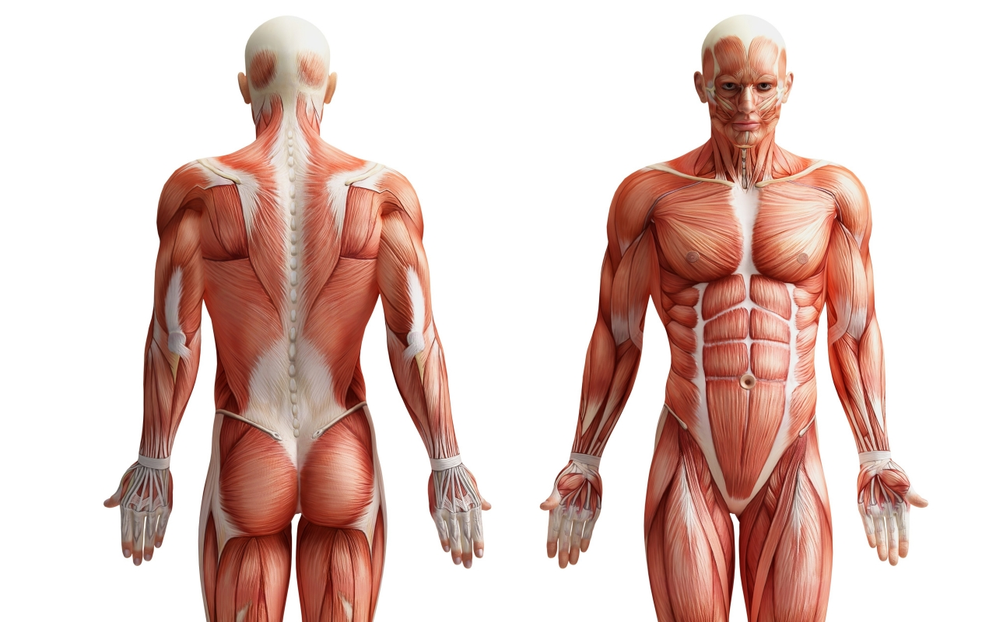
Facial Region
Any potential area of the body that contains muscle
Back
Notes:
Go back to main slide after video and explaination

Slide 9
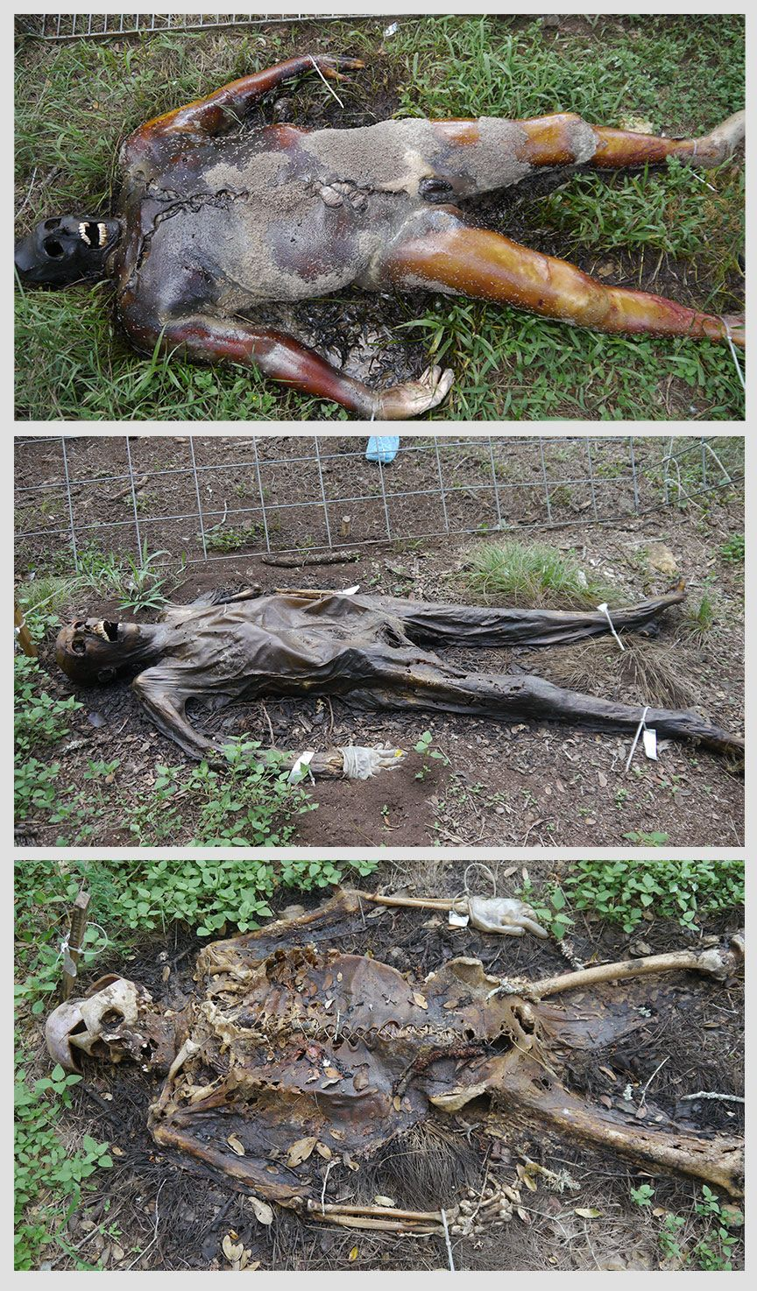
The bloat stage where an accumulation of natural gases fills the body cavity and causes an overall bloated appearance.
The active decay stage is a result where the greatest mass loss. This loss occurs due to the purging of the decomposition fluids and liquefaction of the tissues.
The dry remains stage is where cartilage and bones are present. Therefore, skeletonized remains are the end result of complete decomposition.
1
2
3
Back
Notes:
List the stages

Slide 10
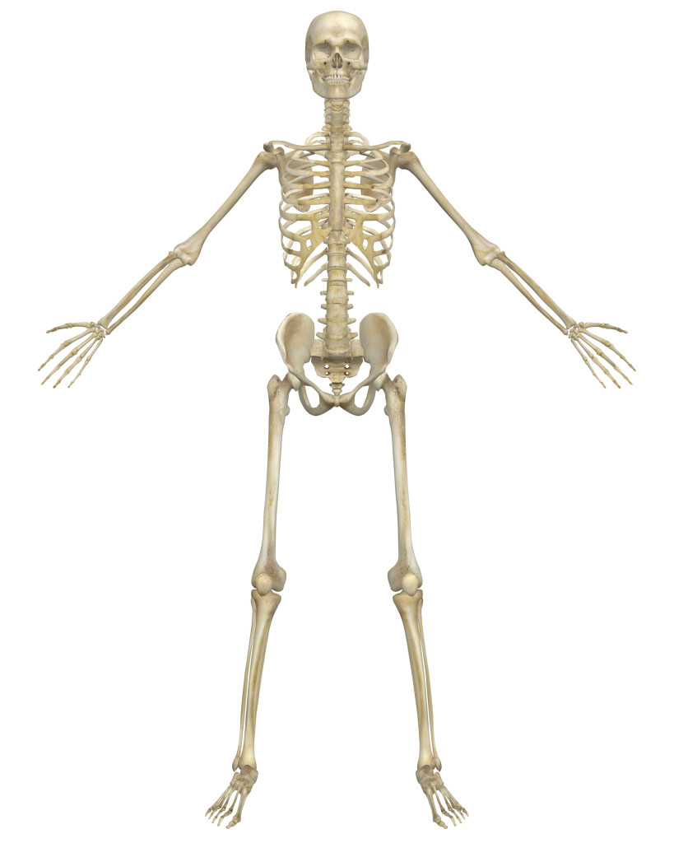
Skull
Teeth
Long Bones
All evidence contributes in determining the cause and manner of death.

Slide 11
C.S.I.
Biology
Anthropology
Chemistry
Criminology

Slide 12
Technical Meaning
mul·ti·dis·ci·pli·nar·y
ˌməltēˈdisəpləˌnerē,ˌməltīˈdisəpləˌnerē/
adjective
combining or involving several academic disciplines or professional specializations in an approach to a topic or problem.

Slide 13
Personal Meaning
mul·ti·dis·ci·pli·nar·y mi·nor
ˌməltēˈdisəpləˌnerē ˈmīnər,ˌməltīˈdisəpləˌnerē ˈmīnər/
noun
1. A well-rounded individual, whom takes full advantage of their resources to make their education more value.

Slide 14
Right now…
Notes:
How does my MST minor help me right now

Slide 15
Deputy Coroner
What is a Deputy Coroner?
Requirements
Responsibilities of a Deputy Coroner?
An official who investigates violent, sudden, or suspicious deaths.
Confirms a decedents identity. Help the pathologist determine cause and manner of death. Assist in autopsies as well as removal of the remains.
Biology, Chemistry, Sociology and Anthropology knowledge background.
High school diploma and some college
1 year experience
ISTB Certification

Slide 16
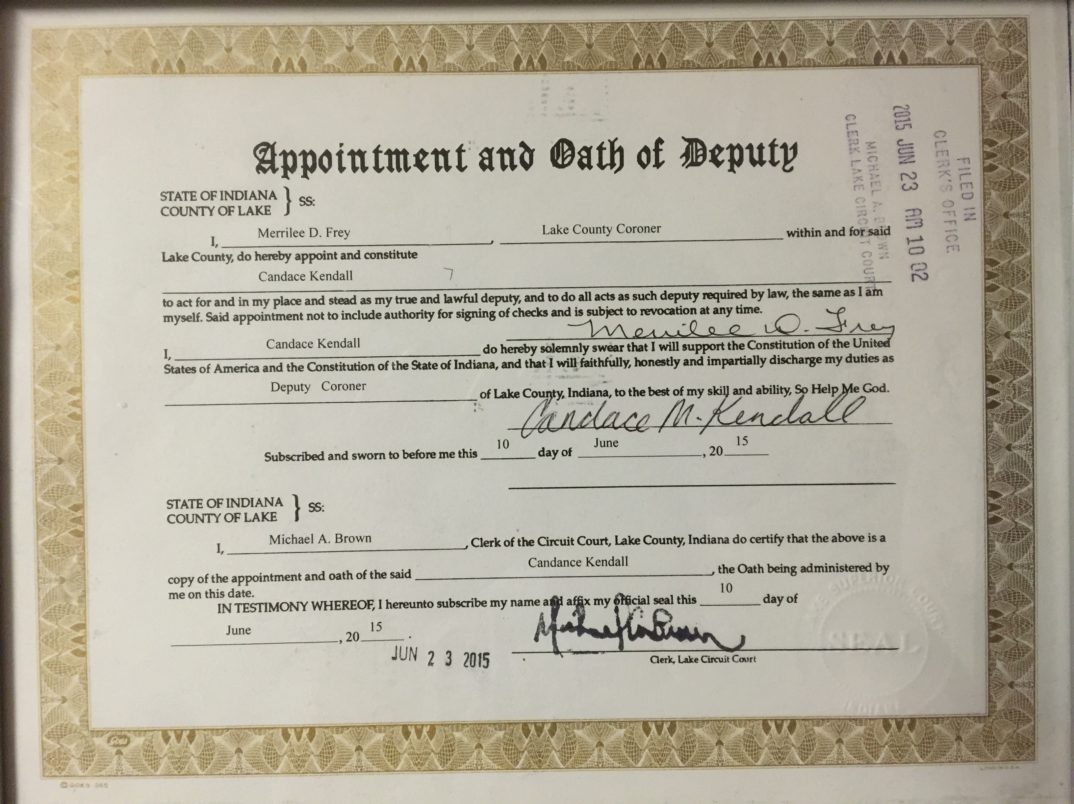

Slide 18
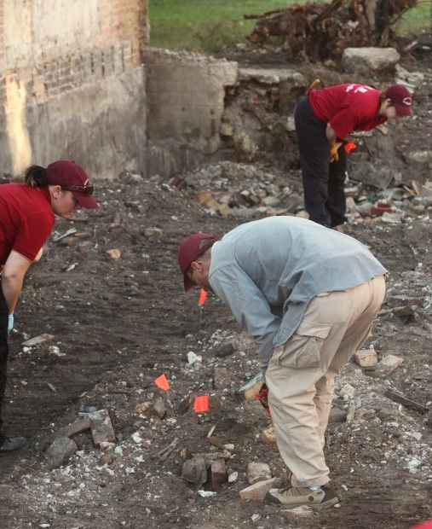
Ancient burial ground? Mummy found in Lake County could be 2,000 years old
A ateam of archaeologists at the site found what ppeared to be mummified human remains that have been there for hundreds of years.
"They're saying it could be 500 to 2,000 years old," Lake County Sheriff John Buncich said. "They could distinguish a head and a torso. It could be a Native American burial ground."
The archaeologists who found the remains had been hired by Cardno Environmental Consultation Co. to search for pre-historic artifacts at the site, which is required in order to get permits for such excavation projects. The sheriff's office and coroner's office were called out to the scene and quickly established the possible human remains were not related to a crime scene, Coroner Merrilee Frey said.
"I contacted and consulted with Dr. Krista Latham and Dr. Stephen Nawrocki, both board certified forensic anthropologists with University of Indianapolis, and together they determined the findings appear to be older than 1940, therefore neither the Lake County coroner's office or criminal investigations will be involved in this case," she said. "The artifacts found at the scene have been determined by the Cardno archaeologists at the scene to possibly be human remains but the exact age is still unknown at this time."
The state's archaeology department, which is part of the Indiana Department of Natural Resources, is now handling the investigation, Frey said.
Even if a crime had been committed, it potentially would be hundreds of years too late to do anything about it, Buncich said.

Slide 19
An investment in knowledge pays the best interest
Benjamin Franklin
Thank you for your time and consideration.
-Candace Marie Kendall

