Slide 1
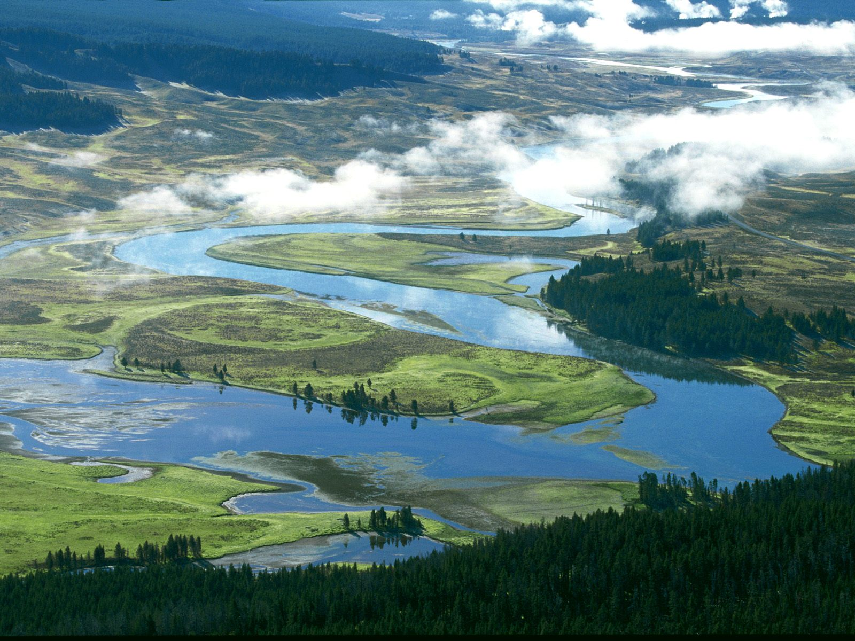
Greater Yellowstone Ecosystem
YNP established 1872, largely to protect geothermal features
YNP has about half the world’s active geysers.

Slide 2
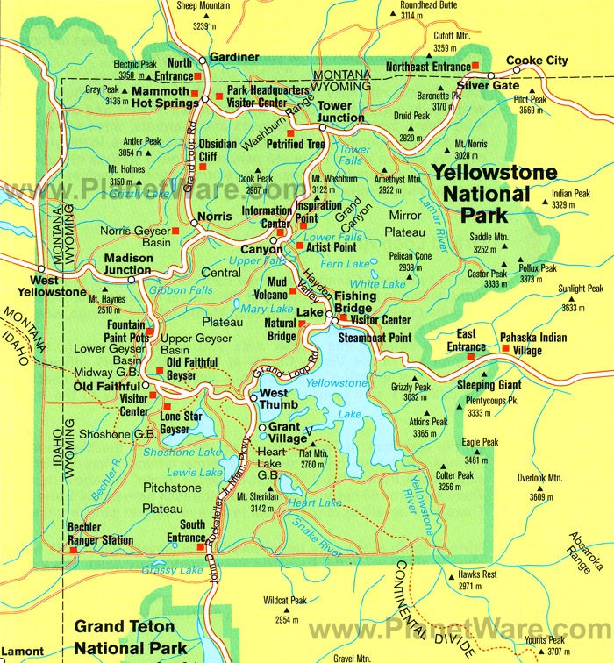
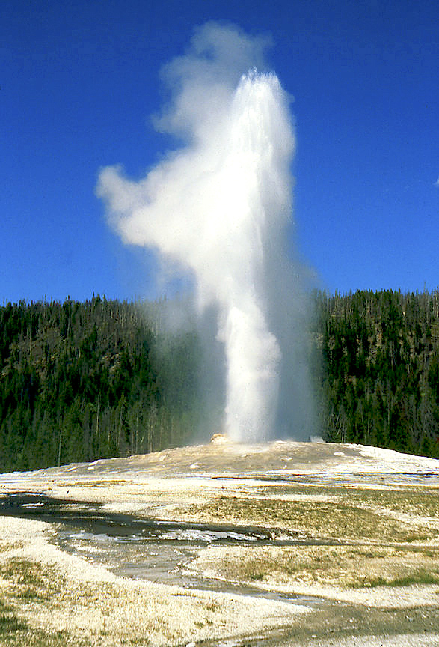

Slide 3
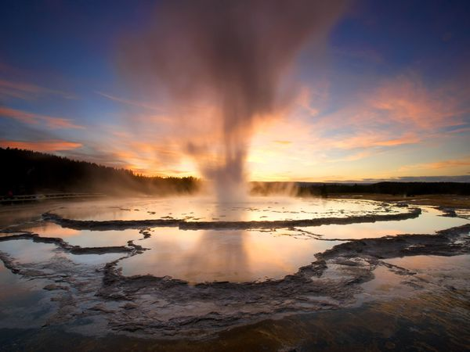
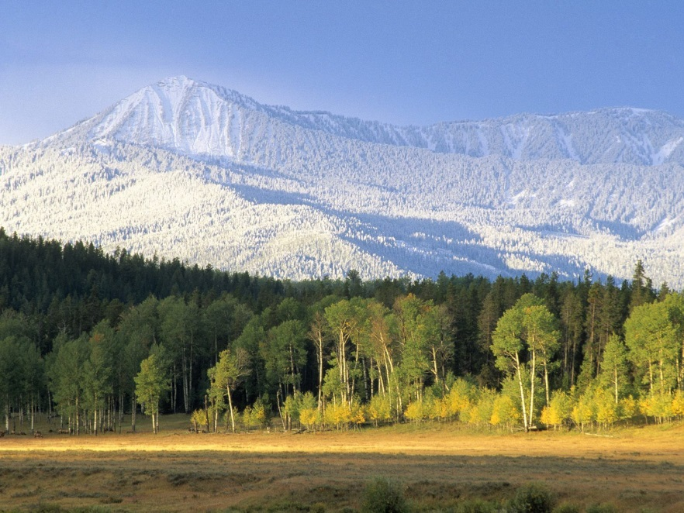
Greater Yellowstone Ecosystem
19,000 – 28,000 sq mi.
Mgt by Fed, State, and tribal governments.
Management Challenges:
climate change
invasive species
land use change
cross political boundaries
forest fires

Slide 4
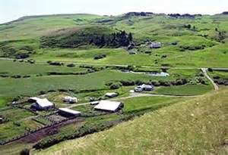
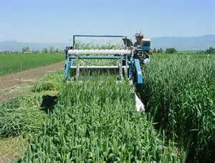
Land Use Patterns
Land use outside the park affects ecology in the park.
Pop in GYE has increased more than 50% since 1990.
About 27% of land is private (mostly valleys).
About 18% used for agriculture.

Slide 5
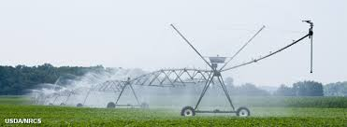
Water Use & Policy
Water rights are old and contested.
Water is pulled from surface (vs ground) sources.

Slide 6
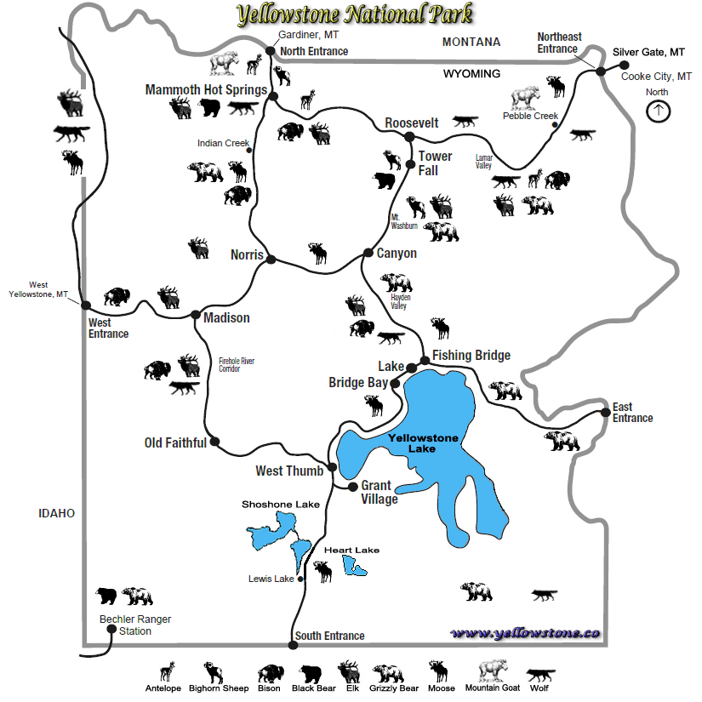
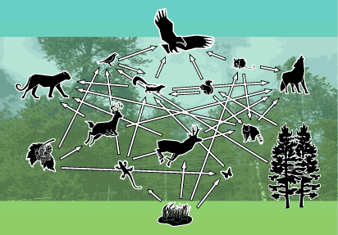
Biodiversity
Eco SYSTEM - All species play important role.
Measures - # species (richness) and abundance (evenness).

Slide 7
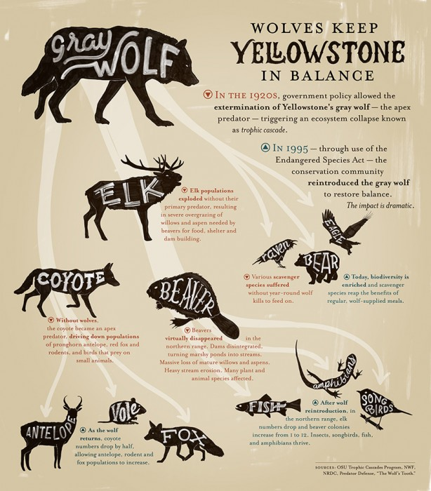
How wolves change rivers in GYE How wolves change rivers
Willows have roared back to life in YNP.
Doug Smith, “ wolves have caused a trophic cascade”.
Elk herd have moved to higher ground.

Slide 8
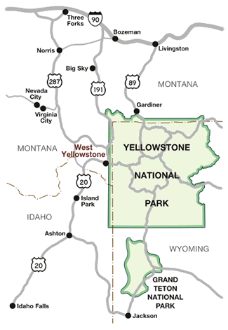
Crossing Political Boundaries
Yellowstone NP was created before surrounding states.
The Park has exclusive jurisdiction over park wildlife, but…
US Forest Service
US Fish and Wildlife Svc
State Governments
Ecological boundaries don’t match social & political ones.

Slide 9
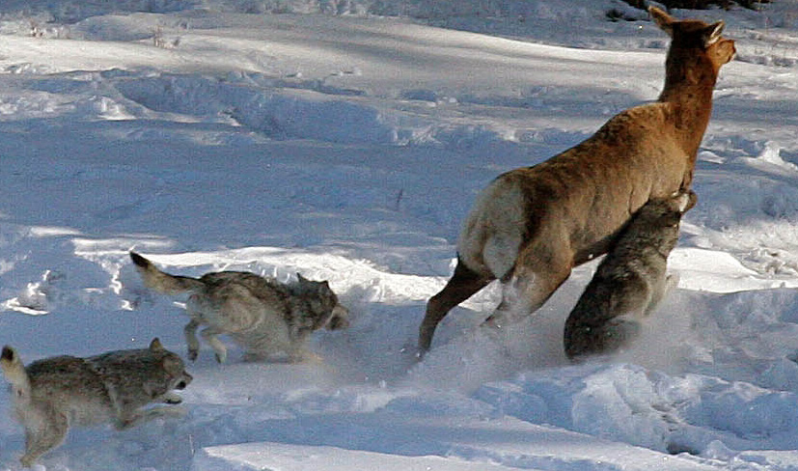
The Park’s Mammals
Largest concentration in lower 48.
Notable for its
predator-prey
complex.
8 ungulate species
7 predators species.
NPS goal is to maintain ecological processes and wildlife and their habitats.

Slide 10
Yellowstone’s Mammals
67 different mammals.
741 Grizzlies and thousands of Black Bears (2012).
Gray wolves restored in 1995, 79 in YNP in 2012.
Wolverines and Lynx, both of which require large undisturbed habitats.
7 Ungulates; elk, mule deer, bison, moose, bighorn sheep, pronghorn and white-tailed deer.
Plus non-native mountain goats.

Slide 11
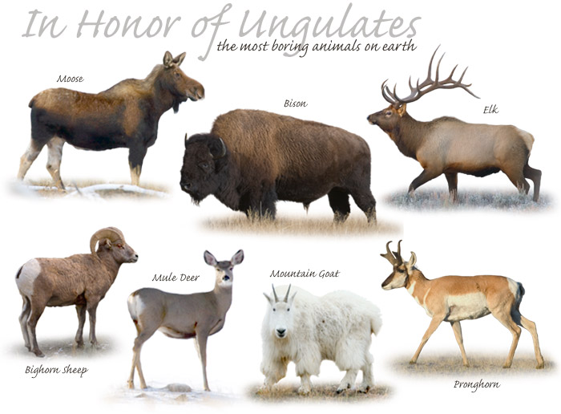
Yellowstone’s Ungulates

Slide 12
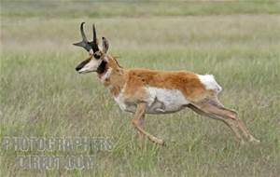
Yellowstone’s mammals
bison romp!
YNP Elk are Ram Tough!
Visitors can fly in Yellowstone
Pronghorn can run 60 mph
For more than a million years, the pronghorn antelope has roamed North America. "The running gait of the pronghorn is beautifully smooth and their powerful legs can carry them at a remarkable pace across the roughest kind of terrain. Pronghorns can reach speeds of 60 mph," notes the National Park Service

Slide 13
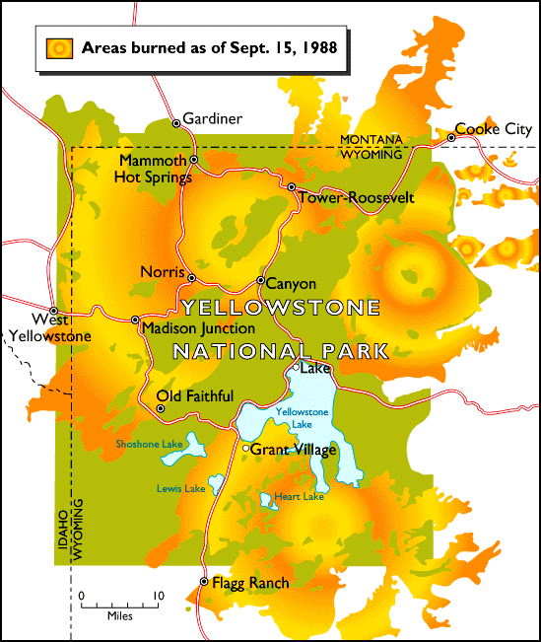
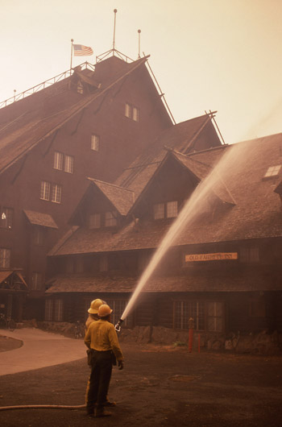
Fire Management
1988 fire
rebirth

Slide 14
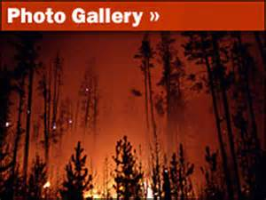
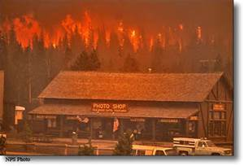
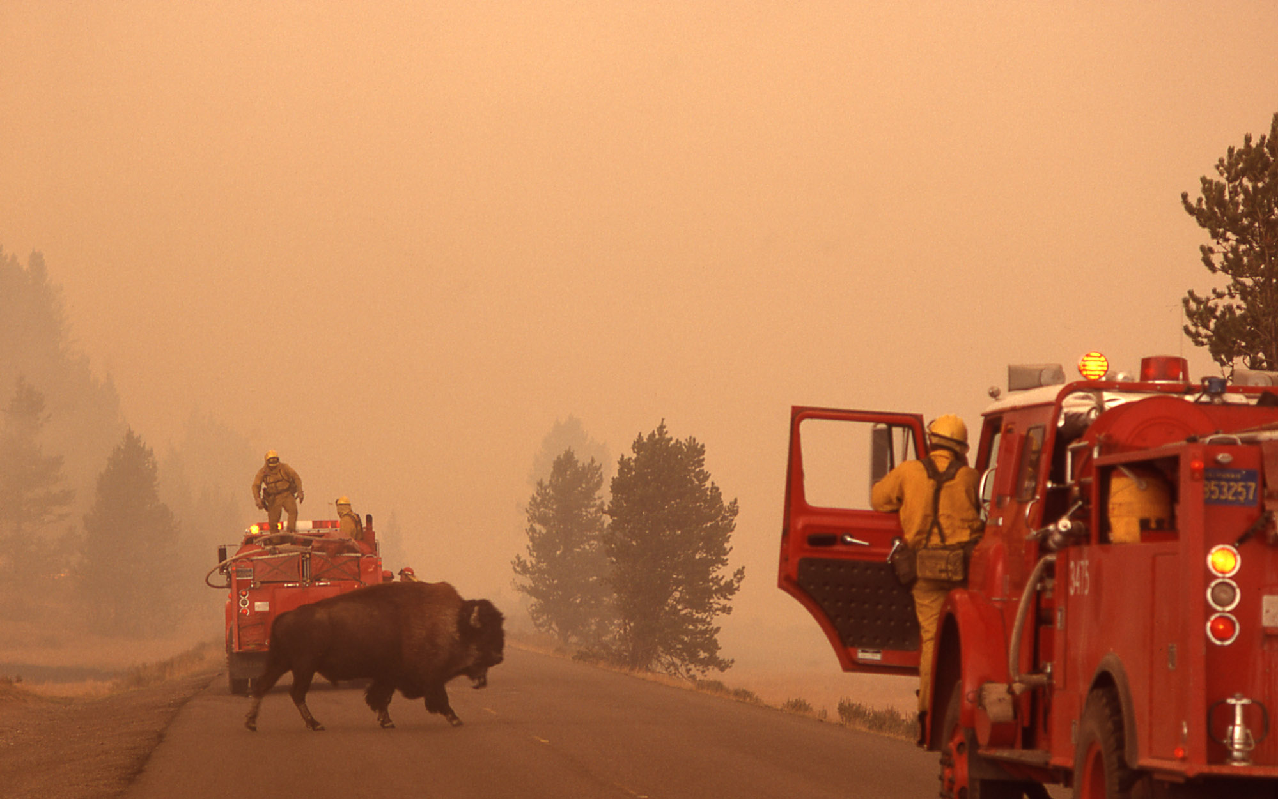

Slide 15
Fire Suppression History and
Current Fire Management Policy
by the National Park Service
Notes:
Fire suppression history in YNP 2009

Slide 16
YNP Fire Management Policy
The Wildland Fire Program has two goals: 1. To suppress wildfires that are human-caused or that threaten people, property or resource values. 2. To ensure that naturally ignited wildland fires may burn freely as an ecosystem process.

Slide 17
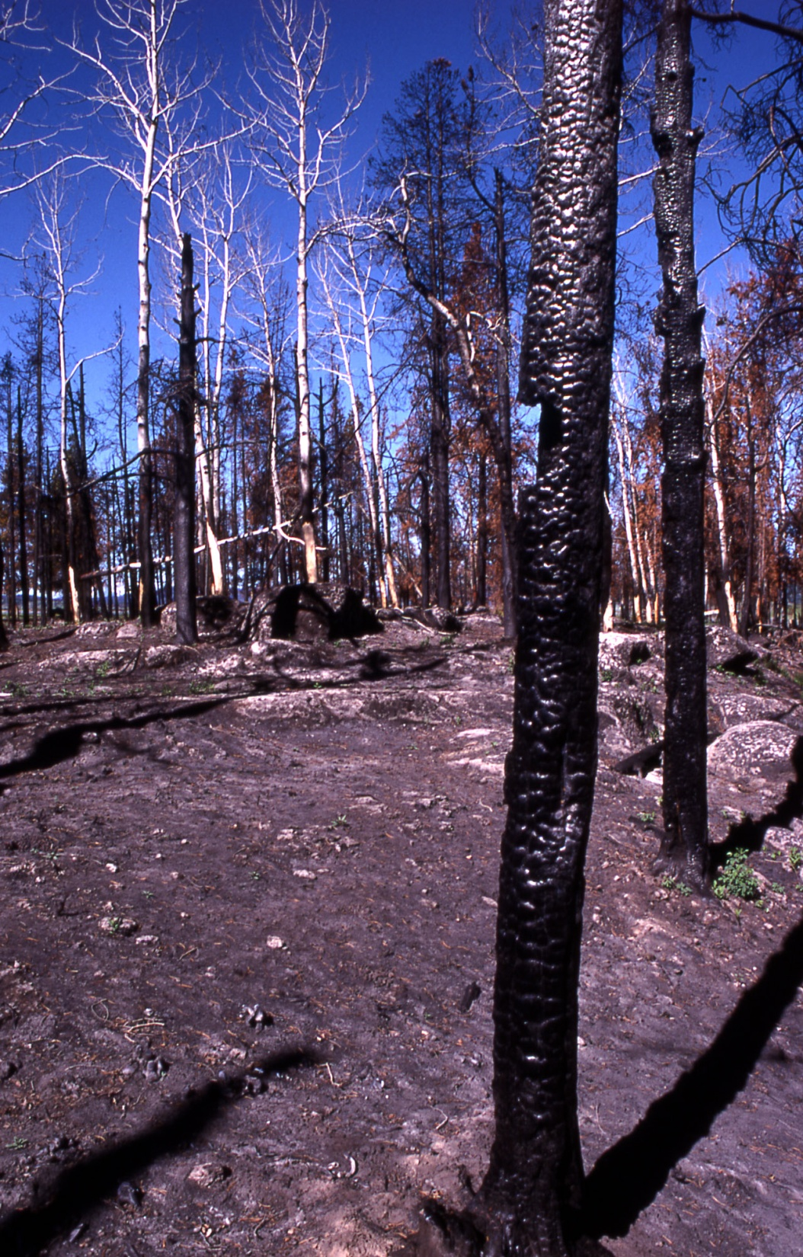
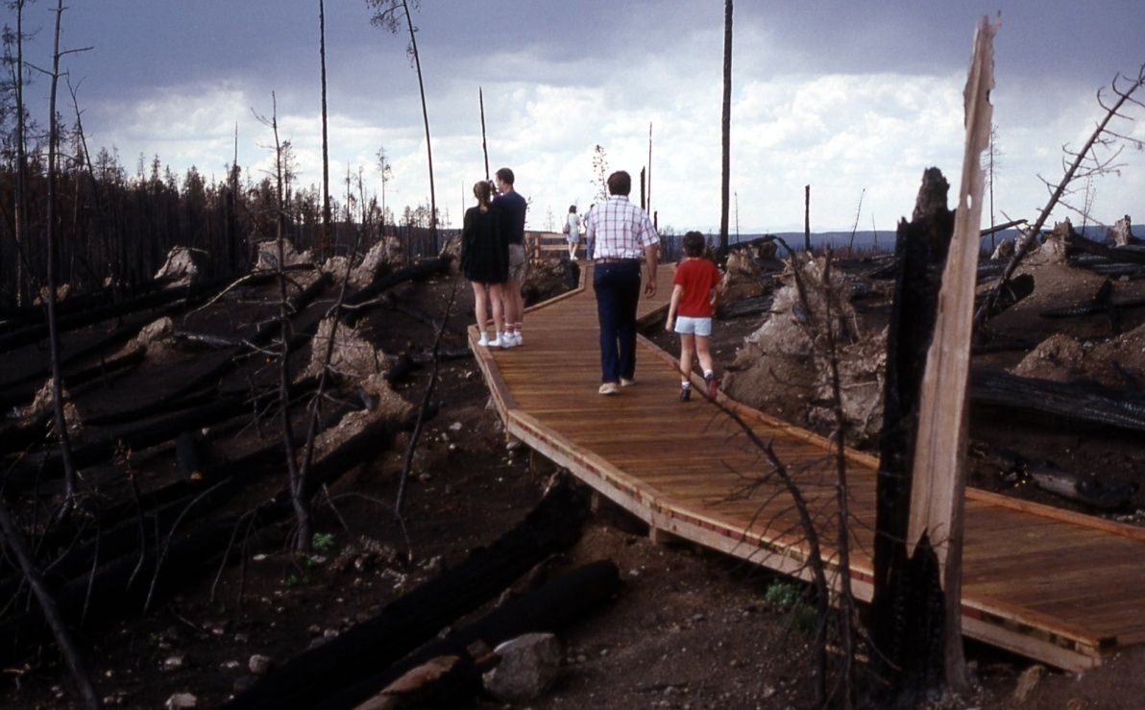
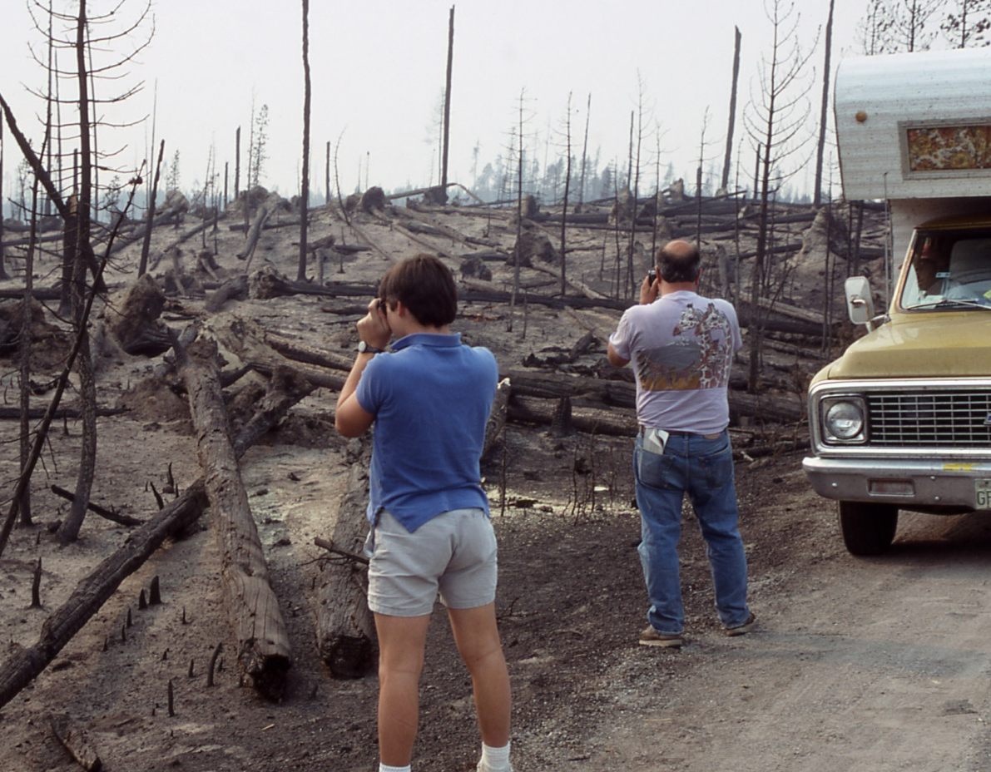
Notes:
Results of high temperature burns in Yellowstone due to huge amounts of unburned fuel stores in the 1900’s.

Slide 18
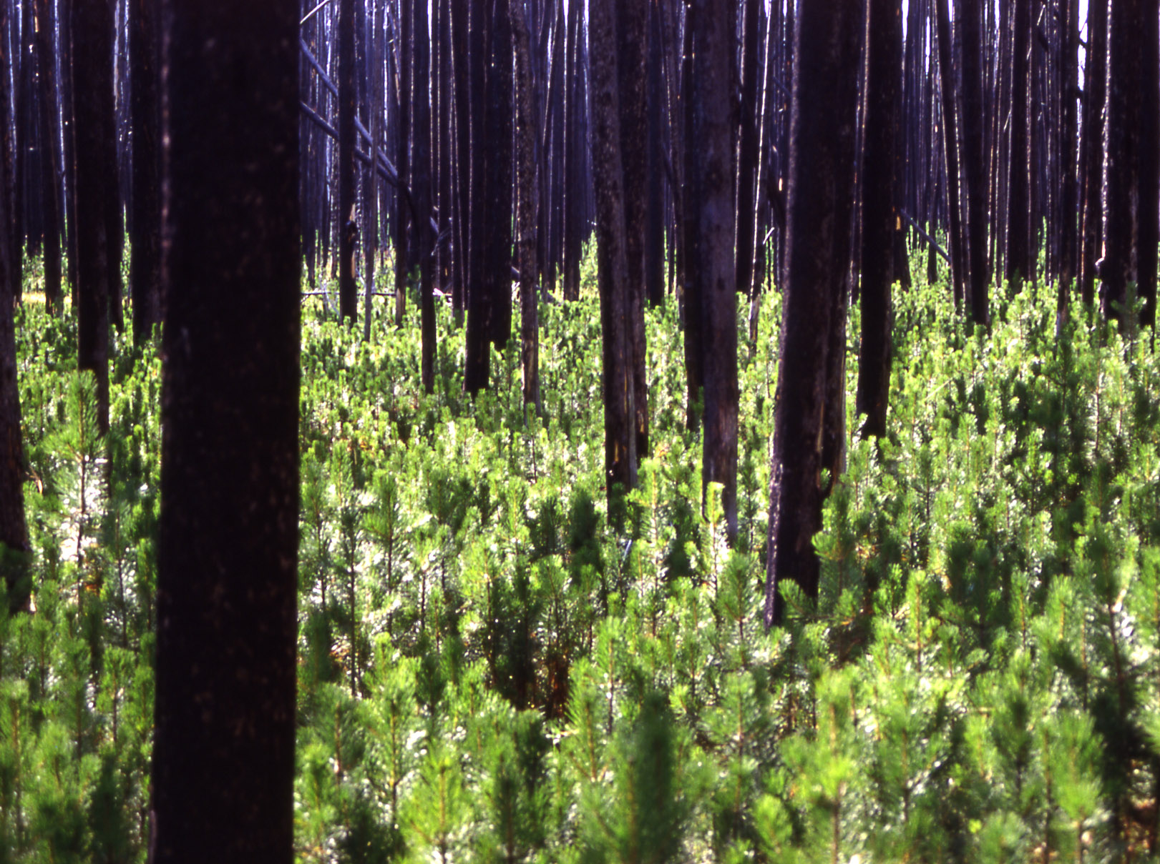
Notes:
tree seedlings regenerate among burned out trees which will eventually fall after rotting or be blown over in strong winds which are often found at YNP.

Slide 19
Lodgepole Pine Forest
Notes:
Naturally reseeded Lodgepole Pine forest from a modest heat fire. Note the distribution of young trees and the slow growth (this picture was taken in 2008 – 20 years after the original burn). Soil conditions are severe and only the hardiest trees survive under these conditions and the severe winters and winds.

Slide 20
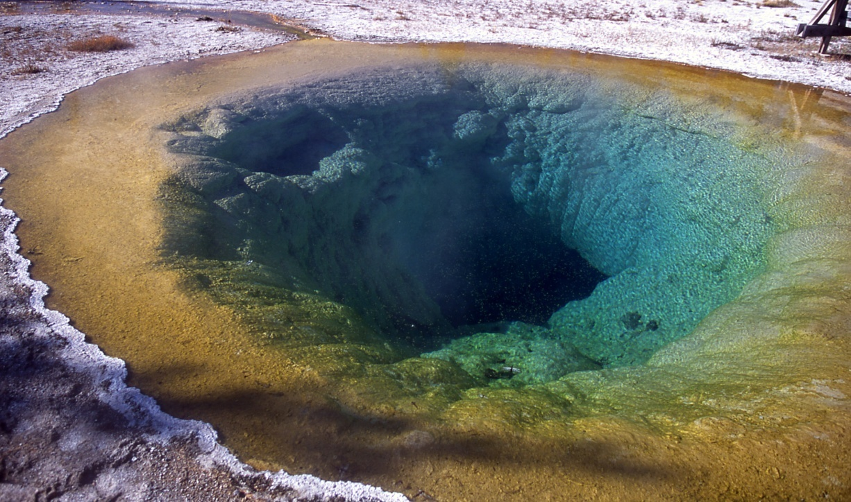
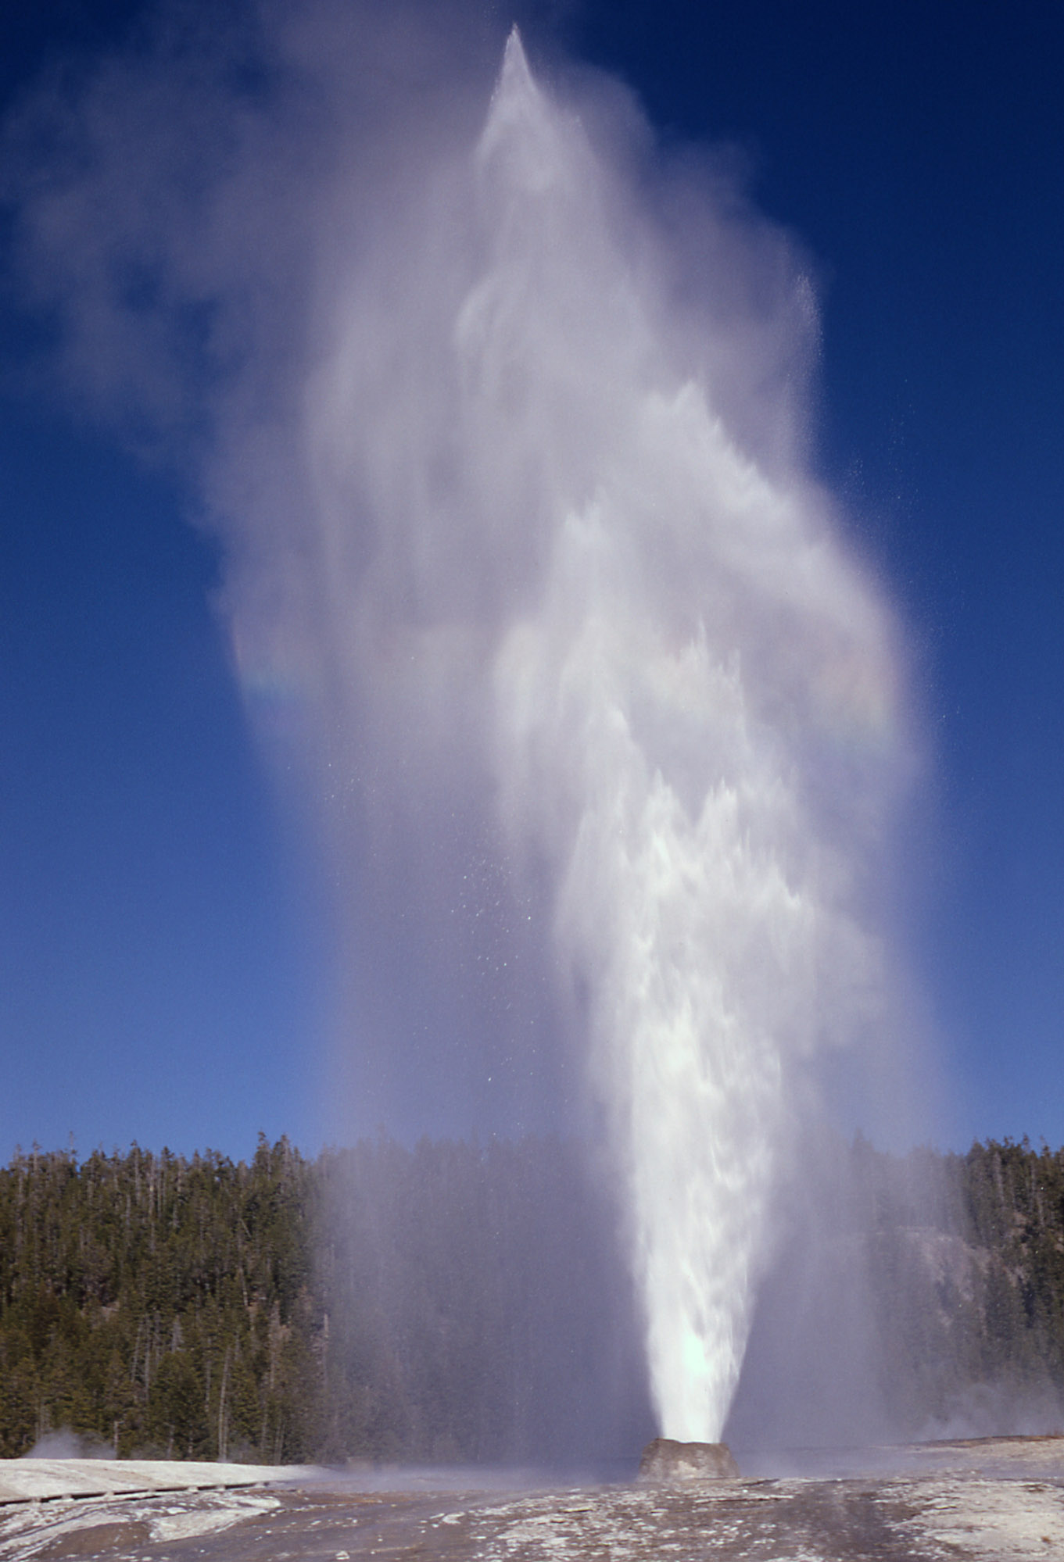
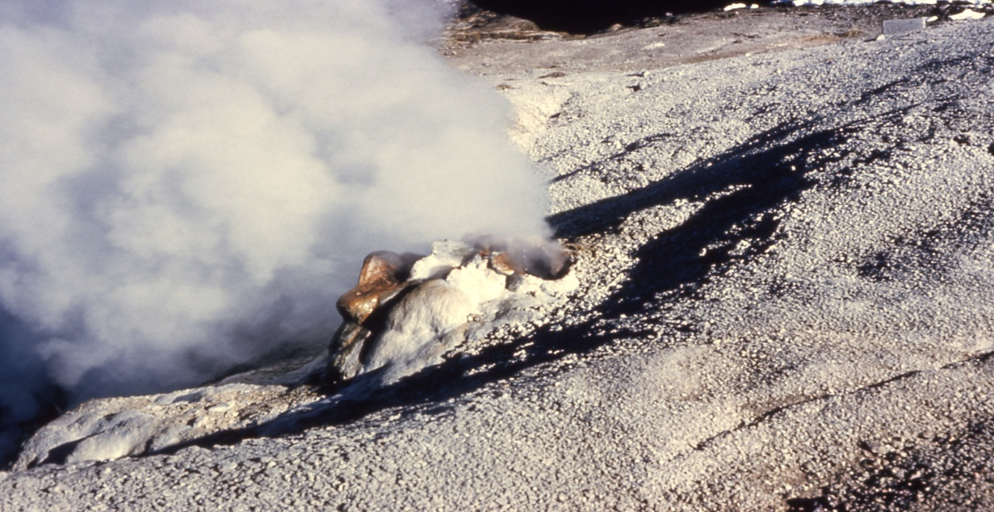
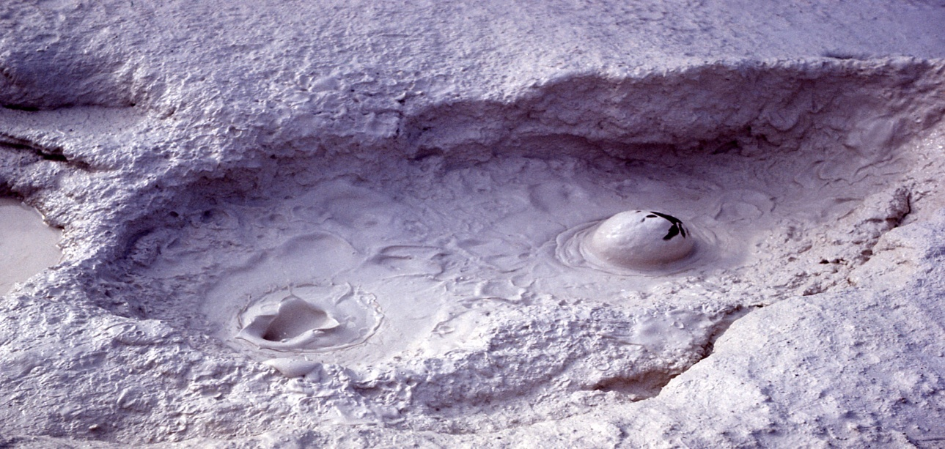
Geothermal Features and Bioprospecting
Notes:
Hot Springs, Fumaroles, Mud Pots and Geysers.
Hot spot = furnace 3 to 5 mile depth.
Surface water comes in contact with the hot magma chamber super heats to temperatures exceeding 400 F due to tremendous pressure from rock and water above it remains in liquid state. Convection currents develop; hot water begins to rise. Pressure is released slowly as hotter/less dense water reaches the surface HOT SPRING.
If there is a constriction along the plumbing system geyser activity or eruptive activity occurs. Expanding steam bubbles build up behind constrictions and force water to overflow at the surface. The release of water at the surface causes a sudden decline in the super-heated water below lowering the boiling temperature of water and allowing steam to form. Water expands rapidly as steam to over 1,500 times its original volume!

Slide 21
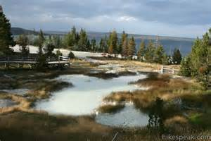
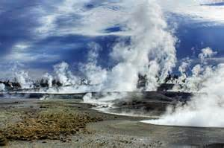
Hot spots Furnace 3 to 5 mile depth
Yellowstone National Park contains more than 75% of the world’s geysers, along with fascinating and colorful mud pots, hot springs and fumeroles, all within seven major basin areas.

Slide 22
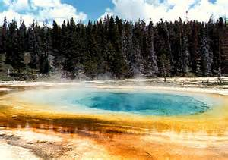
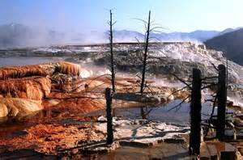
Hot Springs
Heated water creates complex circulation within pools, creating the most colorful features in the park.

Slide 23
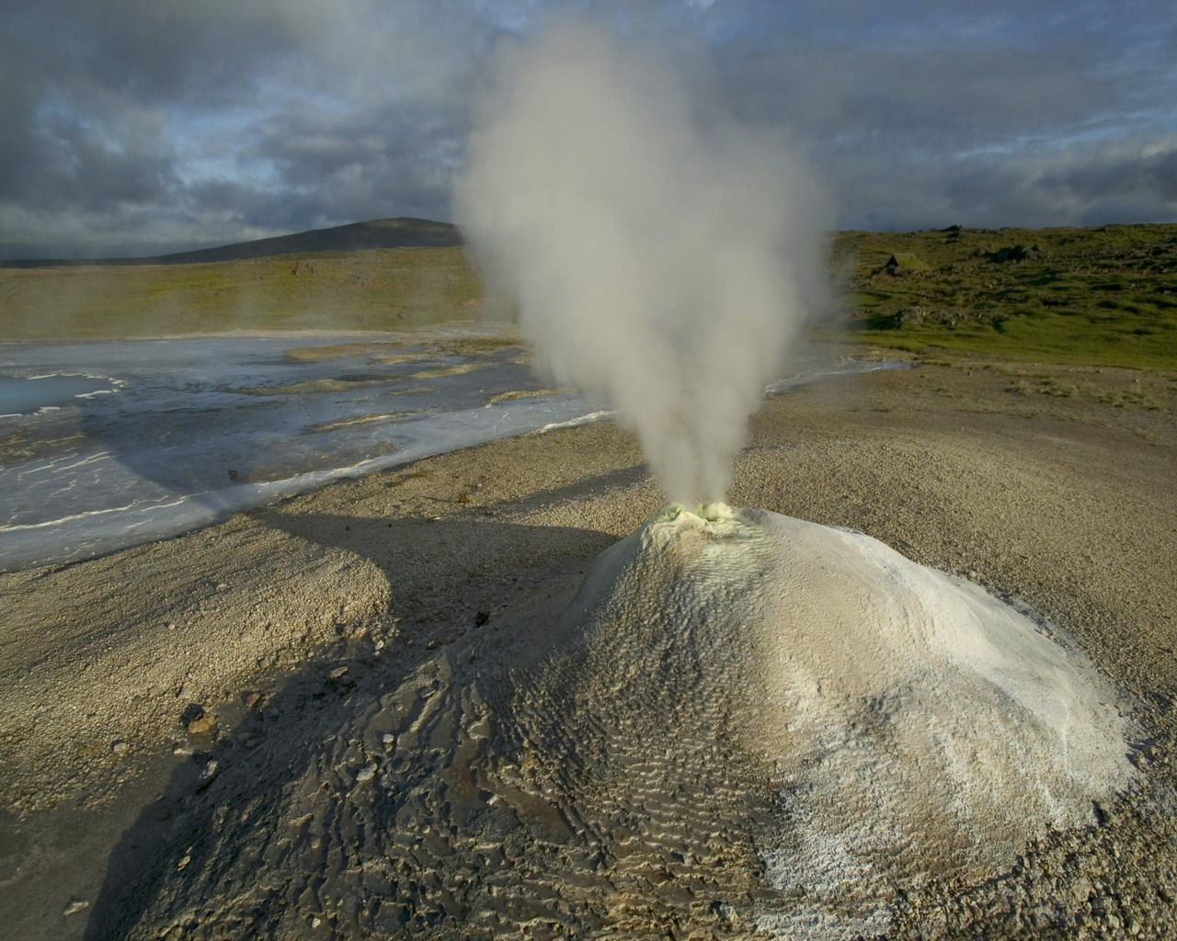
Fumeroles or Steam Vents
Fumeroles/Steam Vents: When a hot spring has more heat than water, the water evaporates before reaching the surface, creating a steam vent or fumerole.

Slide 24
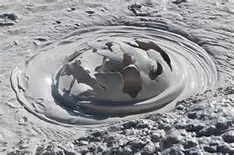
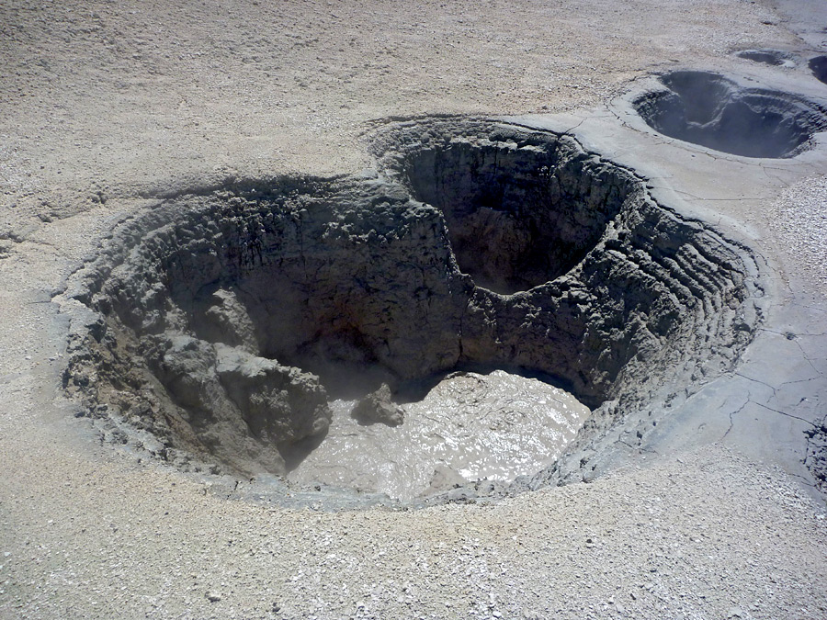
Mudpots
Mudpots:
Acidic features with a limited water supply. Some microorganisms use hydrogen sulfide, which rises from deep within the earth, as an energy source. They help convert the gas to sulfuric acid, which breaks down rock into clay. Various gases escape through the wet clay mud, causing it to bubble

Slide 25
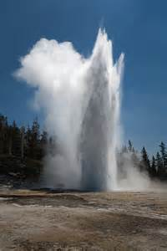
Geysers
If there is a constriction along the plumbing system geyser activity or eruptive activity occurs. Expanding steam bubbles build up behind constrictions and force water to overflow at the surface. The release of water at the surface causes a sudden decline in the super-heated water below lowering the boiling temperature of water and allowing steam to form. Water expands rapidly as steam to over 1,500 times its original volume!

Slide 26
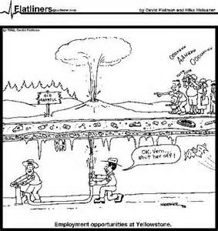
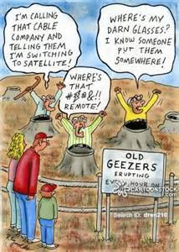
Geysers vs Geezers

Slide 27
Geologic Model of Geothermal Activity

Slide 28
Array of thermophile Colors

Slide 29
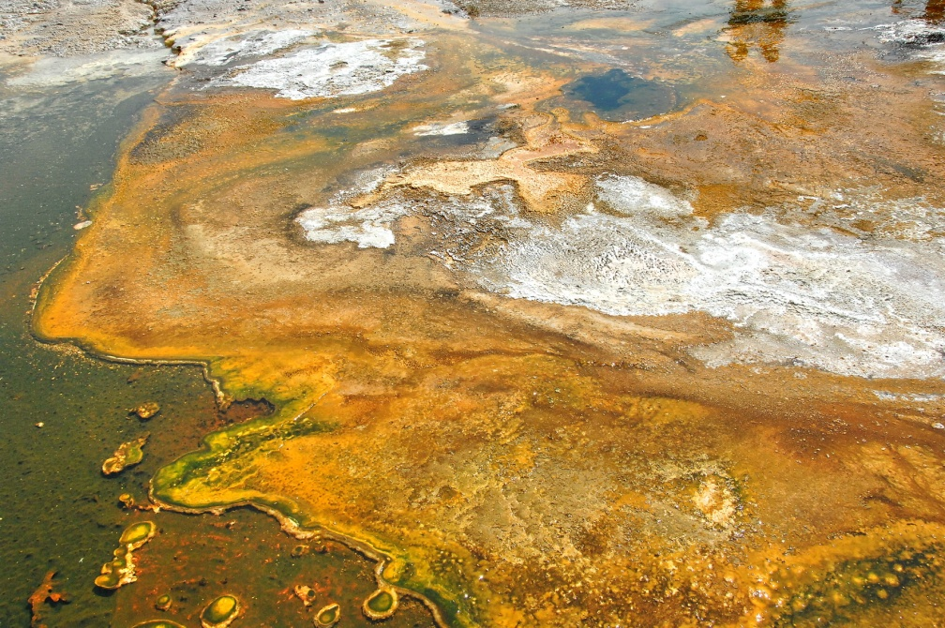
Issue: Bioprospecting
Notes:
Bioprospecting issues in YNP 2008-2009. Consider the intellectual property rights of a National Park such as Yellowstone. The National Park Service will be recovering a portion of any profit from commercialization of intellectual property or discovery of new organisms/enzymes/applications of anything found in the YNP system. Almost every research project in Yellowstone’s hot springs, geysers, and other thermal areas harboring organisms that have adapted to such harsh environments, has yielded new and potentially advantageous discovery’s. The NPS plans to harvest some of the profits from these discovery’s through fees and give-backs (percentages).

Slide 30
Winter Use Mgt Goals
Provide high quality, safe, educational experience.
Provide visitor and employee health and safety.
Protect wilderness character and values.
Preserve pristine air quality.
Preserve natural soundscapes.
Mitigate impacts to wildlife.
Coordinate with partners & gateway communities.

Slide 31
Public Concerns
Overcrowding
Visitor impacts on natural resources
Noise and air pollution
Availability of facilities and services
Restricting snowmobiles – require guides
Impacts on local and regional economies
Wildlife using OSV groomed roads
www.nps.gov/yell/planyourvisit/winteruse.htm

Slide 32
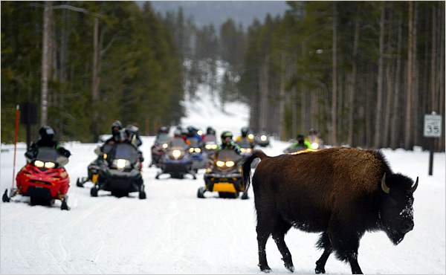
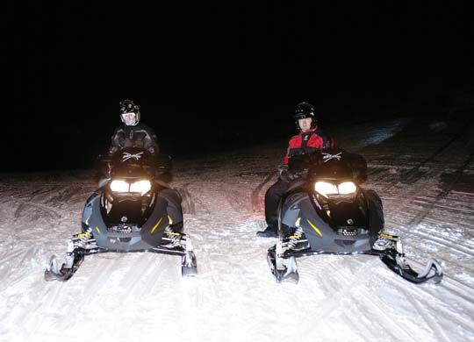
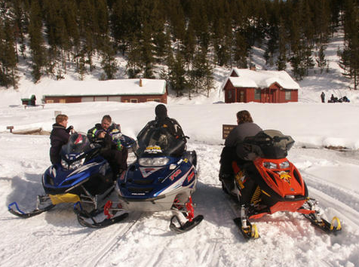
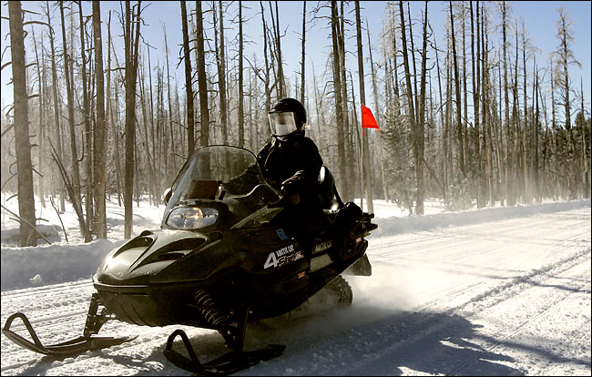
Notes:
Gail Norton, former Department of the Interior director and avid outdoors person, on snowmobile in YNP, bottom right picture. Snowmobiles provide a compacted base from which bison tend to migrate/move through the park. Sometimes, the bison actually follow the snowmobile roads out of the park and then are either killed or hazed back into the park. Winter use has consequences and benefits.

Slide 33
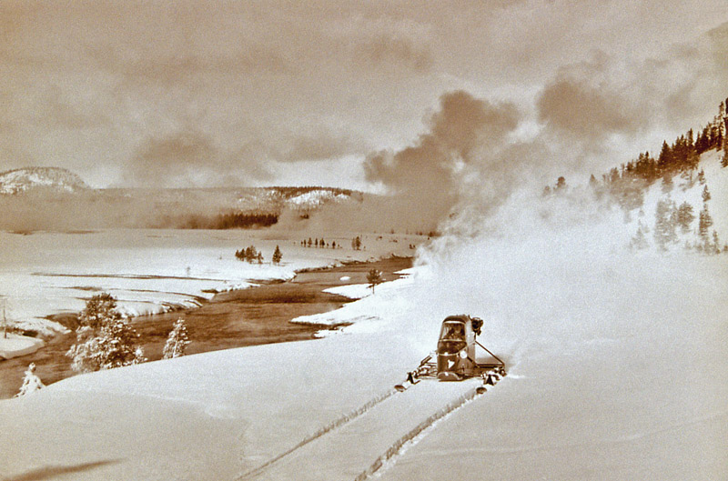
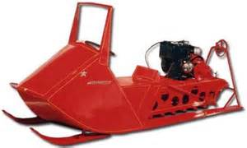
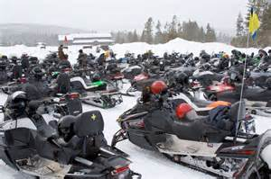
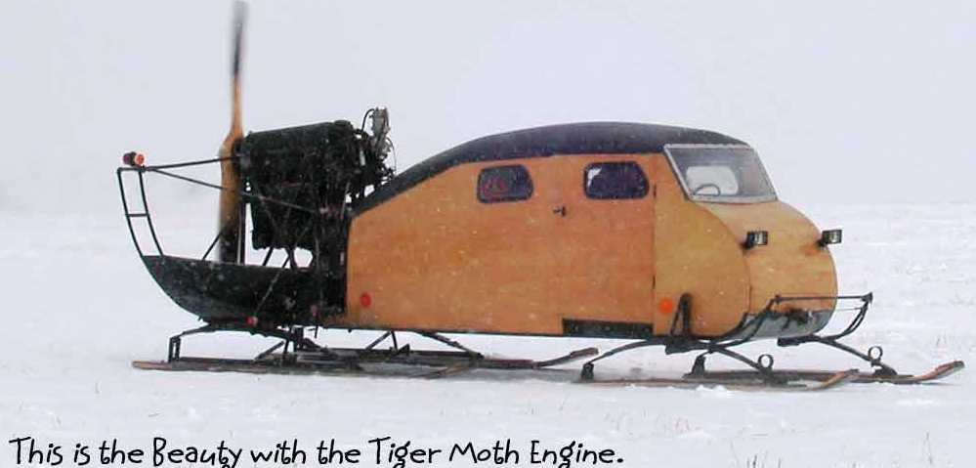
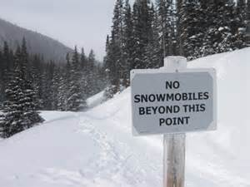

Slide 34
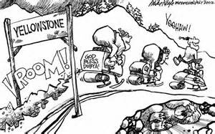
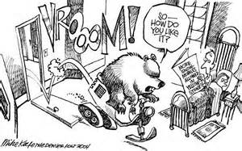
New Best Available Technology
new BAT

Slide 35
Park History
European Americans began exploring in early 1800s.
First “organized” expedition in 1870.
YNP is established in 1872.
Railroad arrives in 1883, allowing easier access.
US Army manages park from 1886 thru 1918.
NPS created in 1916.
Leopold Report created wildlife mgt policies 1963.

Slide 36
Park History
1988 FIRE!
1995 Wolves are reintroduced to YNP.

Slide 39
Protection or Pleasure?

