Slide 1
The Social and Ecological Conflicts inherent in sustainable local economic development projects in a global economy International Conference on Sciences and Social Sciences for Sustainable Development At Rajabhat Maha Sarakham University, Thailand 21-22 July 2011
John Conant, Professor and Chair
Department of Economics
Stephen Aldrich, Assistant Professor
Department of Earth and Environmental Systems
Indiana State University, Terre Haute IN 47809 USA

Slide 2
Conflicts
Conflicts often occur over the use of scarce resources, especially land and water. Sources of these conflicts include:
Definition of Property Rights
Valuation Problems in Project Analysis
Inter-Group or Interest Group Goals/Objectives
Cultural Conflicts

Slide 3
Conflicts
Conflicts can also occur when resources are plentiful. Sources of “conflicts in abundance” include:
Power relationships
Political economy of access
Control over resources

Slide 4
Sustainability – What We (ECSLED) Mean
Sustainability can mean many things.
Environmental
Cultural
Economic
Political
Social
All are necessary for a project to be “sustainable”.

Slide 5
Sustainability Team Building
The main argument we are making is for the necessity of multi-disciplinary team building for the planning, implementation, and analysis of sustainability projects and the public policy that supports the creation of sustainable projects.

Slide 6
Sustainability Team Building
Disciplinary Perspectives: valuable but narrow?
Once upon a time, there lived six blind men in a village. One day the villagers told them, "Hey, there is an elephant in the village today." They had no idea what an elephant is. They decided, "Even though we would not be able to see it, let us go and feel it anyway." All of them went where the elephant was. Everyone of them touched the elephant. "Hey, the elephant is a pillar," said the first man who touched his leg. "Oh, no! it is like a rope," said the second man who touched the tail. "Oh, no! it is like a thick branch of a tree," said the third man who touched the trunk of the elephant. "It is like a big hand fan" said the fourth man who touched the ear of the elephant. "It is like a huge wall," said the fifth man who touched the belly of the elephant. "It is like a solid pipe," Said the sixth man who touched the tusk of the elephant.
Moral of the Story?

Slide 7
ECSLED’s Vision (Environmentally and Culturally Sustainable Local Economic Development)
Multidisciplinary: Environmental Science, Biology, Economics, Political Science, Sociology, and the Arts.
Necessity for effective public policy making with regard to sustainability projects.
Educationally: Demonstrate effective policy making processes for sustainability through “experiential learning and community engagement”.

Slide 8
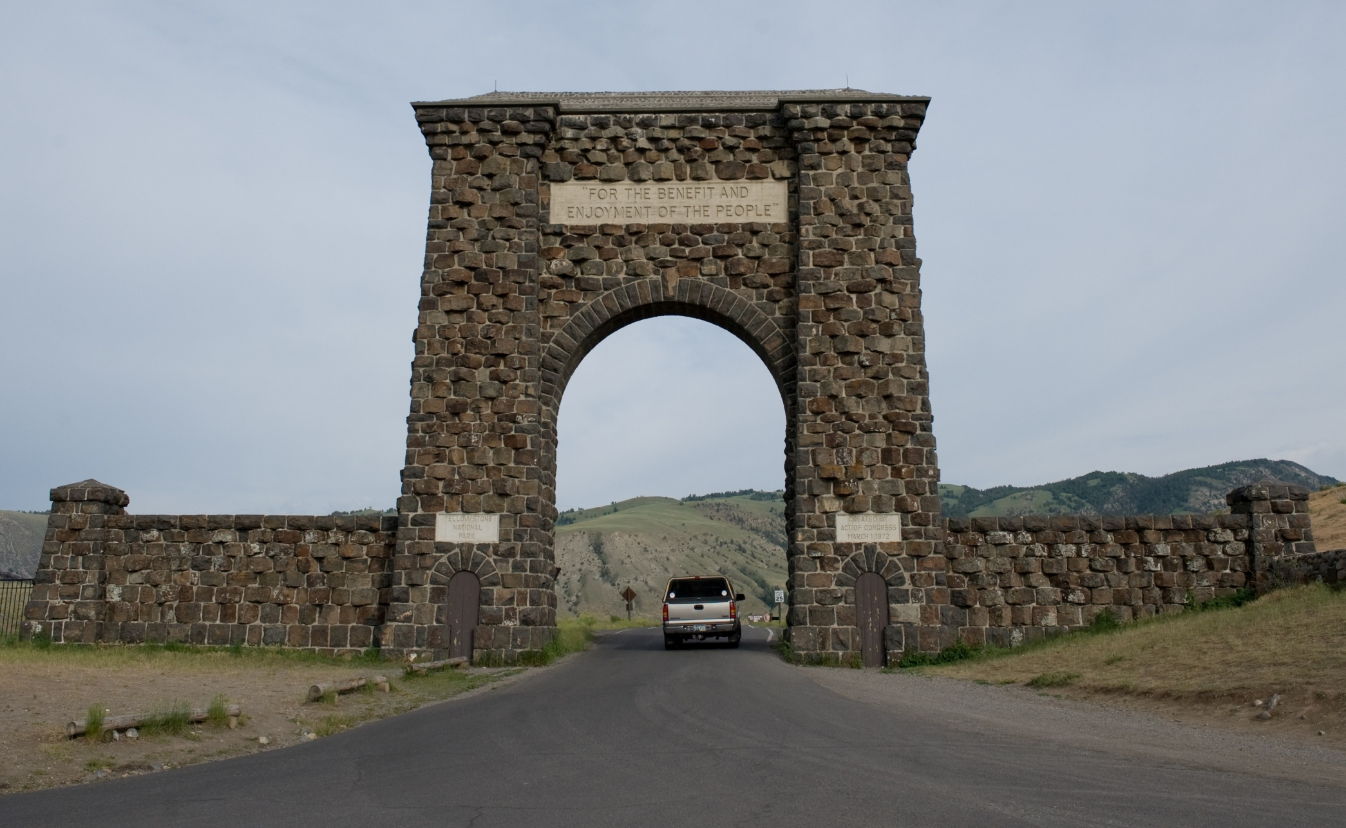
Yellowstone National Park For The Benefit And Enjoyment Of The People Preservation – Conservation – Recreation

Slide 9
Conflict of Interests: Environmentalists See Parks as Sacred Temples of Nature

Slide 10
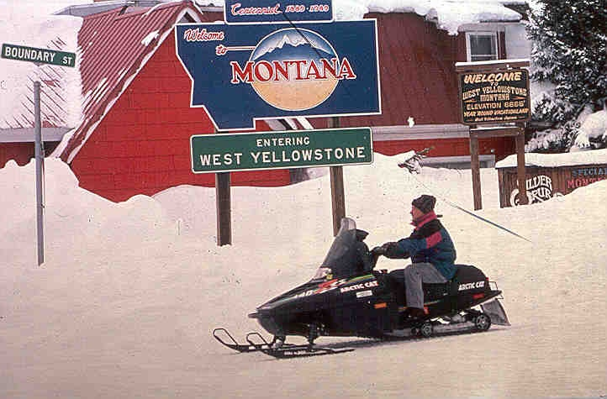
West Yellowstone: Gateway communities see an economic asset for development.
Notes:
West Yellowstone, Montana, at the park’s western entrance, has made itself a winter economy based largely upon the snowmobile. It bragged at one time that it was the “Snowmobile Capital of the World.” Snowmobiling has transformed the town from a sleepy hibernacula to a buzzing, busy town; some merchants earned more in Feb. than any other month.
Banning snowmobiles threatens the town’s identity; its cultural geography.

Slide 11
Property Rights
Tragedy of the Commons – Economic overuse of scarce (and hence valuable) resources.
Insecure Property Rights – Underinvestment in economic/environmental/cultural enhancements.
Can exacerbate “conflict in abundance”
Externalities – Inability to capture gains or ability to escape opportunity costs associated with project.
Takings – Formal asset (land) taking or Informal (land/water) use restrictions via regulation.
Often the course of “conflict in abundance”

Slide 12
Tragedy of the Commons
Most valuable property right is right to exclude.
No right to exclude means zero opportunity cost of use by any individual/group.
Result is asset is “used” as long as use provides any benefit at all; despite opportunity cost.
Examples: fisheries, forests, oceans, fluid mining

Slide 13
Tragedy of the Commons
What is the opportunity cost to these individuals of their activity on this public land?
Who is enjoying the benefits?
Who is bearing the costs?
Failure of property rights system occurs whenever there is a separation between those who reap the benefits and those who bear the costs.
How do you internalize the costs and benefits to the decision-makers who are determining the land’s use?

Slide 14
Underinvestment
Without secure property rights there is no way to secure the returns to investment.
Lack of secure rights may have variety of causes:
Quasi-public/private legal ownership
Regulations on use of privately owned assets
Insufficiency of property law institutions
Political uncertainty/instability
Sometimes even violence

Slide 15
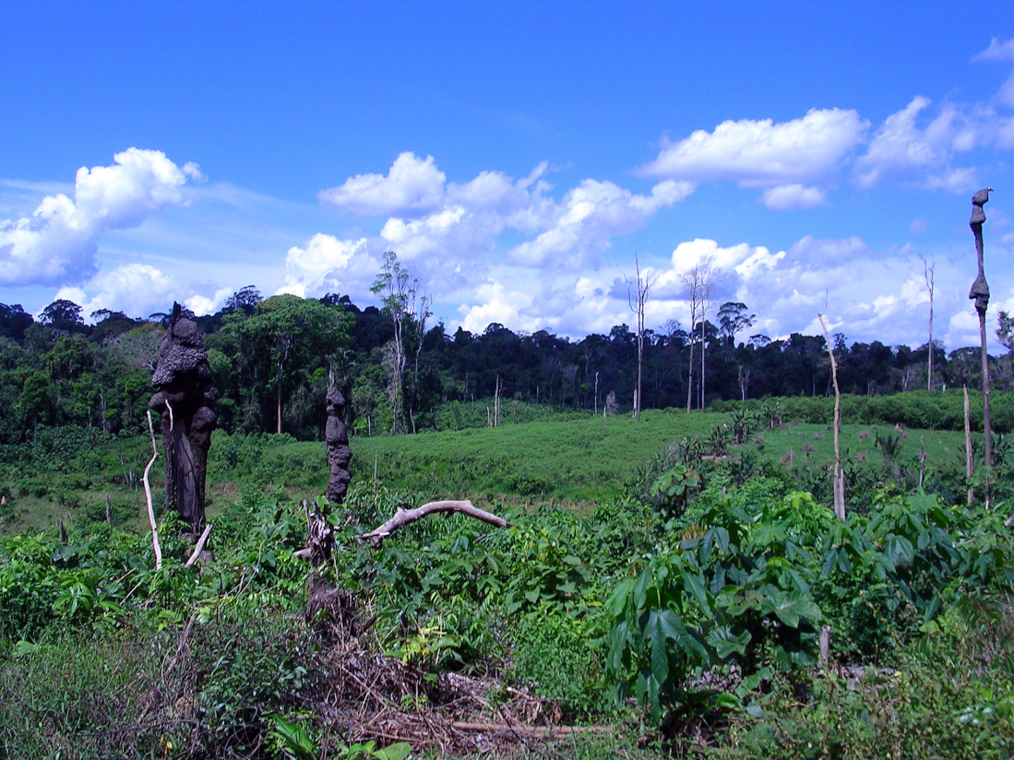
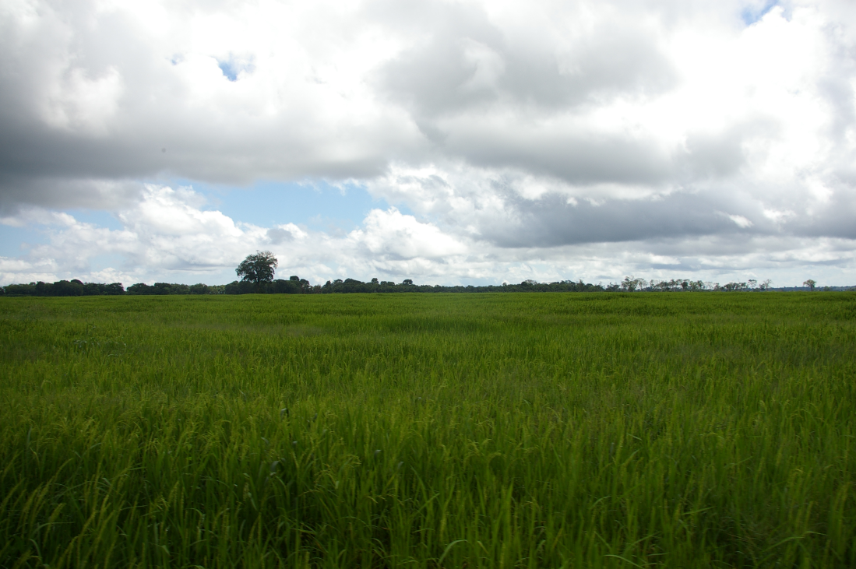
Uncertain/insecure property rights reduce incentive for investment.
In the Amazon agricultural productivity and property rights go hand-in-hand:

Slide 16
Externalities
Externalities occur when parties to a transaction do not capture/bear all of the benefits/costs inherent in the transaction.
External Economies (benefits) – Markets provide too little.
External Diseconomies (costs) – Markets provide too much.
Examples: pollution, education

Slide 17
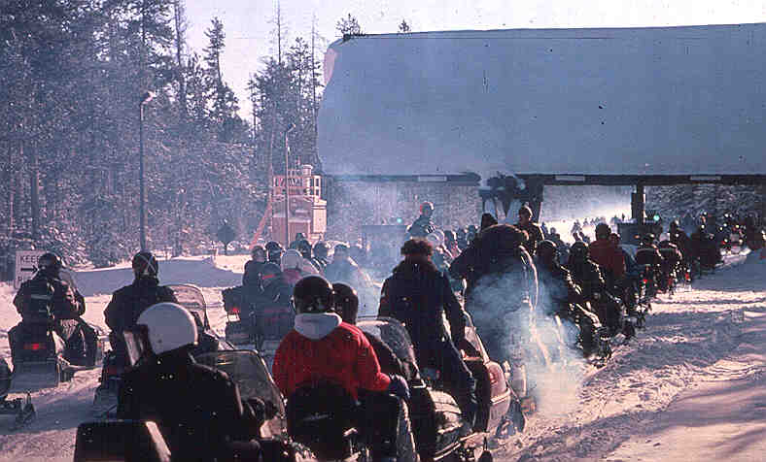
Air Pollution: Classic External Cost

Slide 18
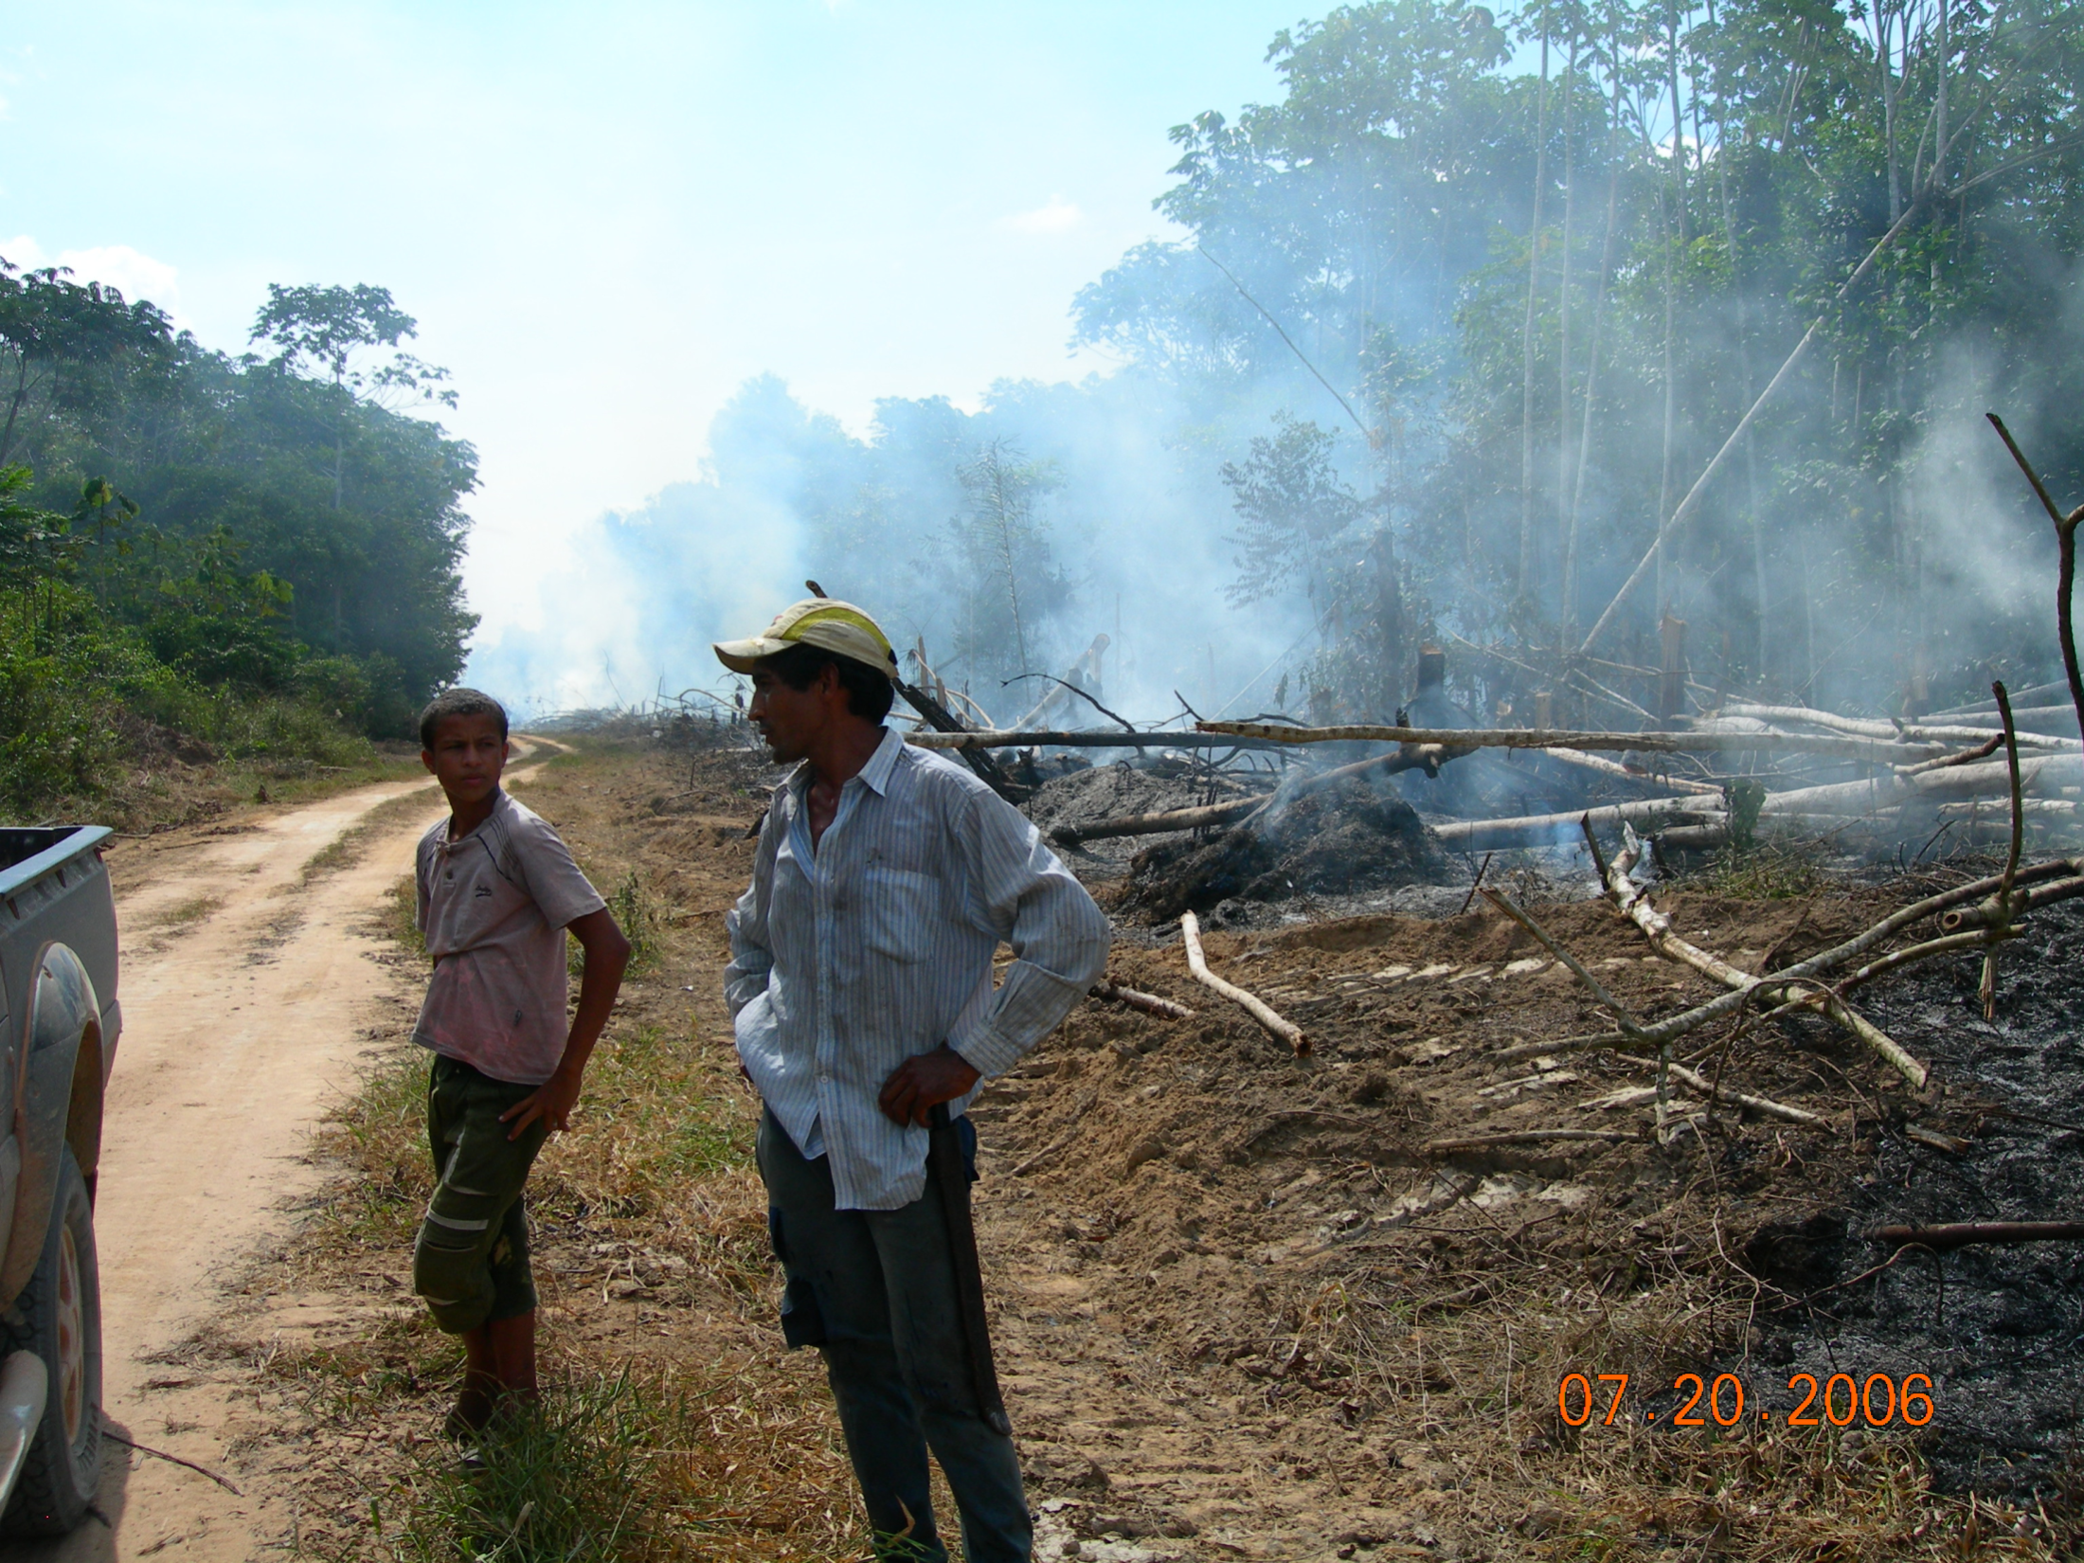

Slide 19
Takings
Formal – legal taking of economic asset (land).
Informal – legal restriction on use of asset which reduces the value of an economic asset.
Not In My Backyard (NIMBY) – a negative externality that can result from geographical placement of private or public projects.
Examples: Building in flood or protected wetlands areas.

Slide 20
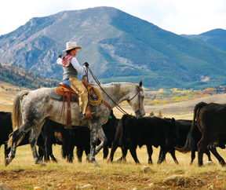
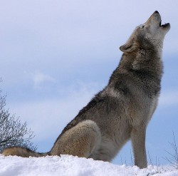
A Regulatory Taking
This April 13, 2009 file photo provided by the Oregon Department of Fish and Wildlife shows two wolves standing near the bodies of 2 dead lambs in Baker County, Ore. The Oregon Cattlemen's Association is pressing a package of bills in the Oregon Legislature that would give ranchers the right to shoot wolves attacking livestock, and pay ranchers compensation for wolf kills.

Slide 21
Project Valuation
Resource Scarcity Mandates Tradeoffs – Decisions require information (data).
Non-Market Goods & Services – Markets provide signals about scarce resource value and opportunity costs.
Intertemporal Valuations – Discounting future benefit streams and calculations of Net Present Values.

Slide 22
Valuing Non-Market Goods & Services
Non-Market means normal price signals either non-existent or non-efficient.
Substitutes for market process in order to “simulate” market pricing – socialist calculation problem.
Willingness to pay for “Public Goods” (open vistas, securing environmental/cultural services for future generations, etc.)
Free-Rider Problems.

Slide 23
What is this vista worth? To whom? Break up ranch for housing development or a WalMart?

Slide 24
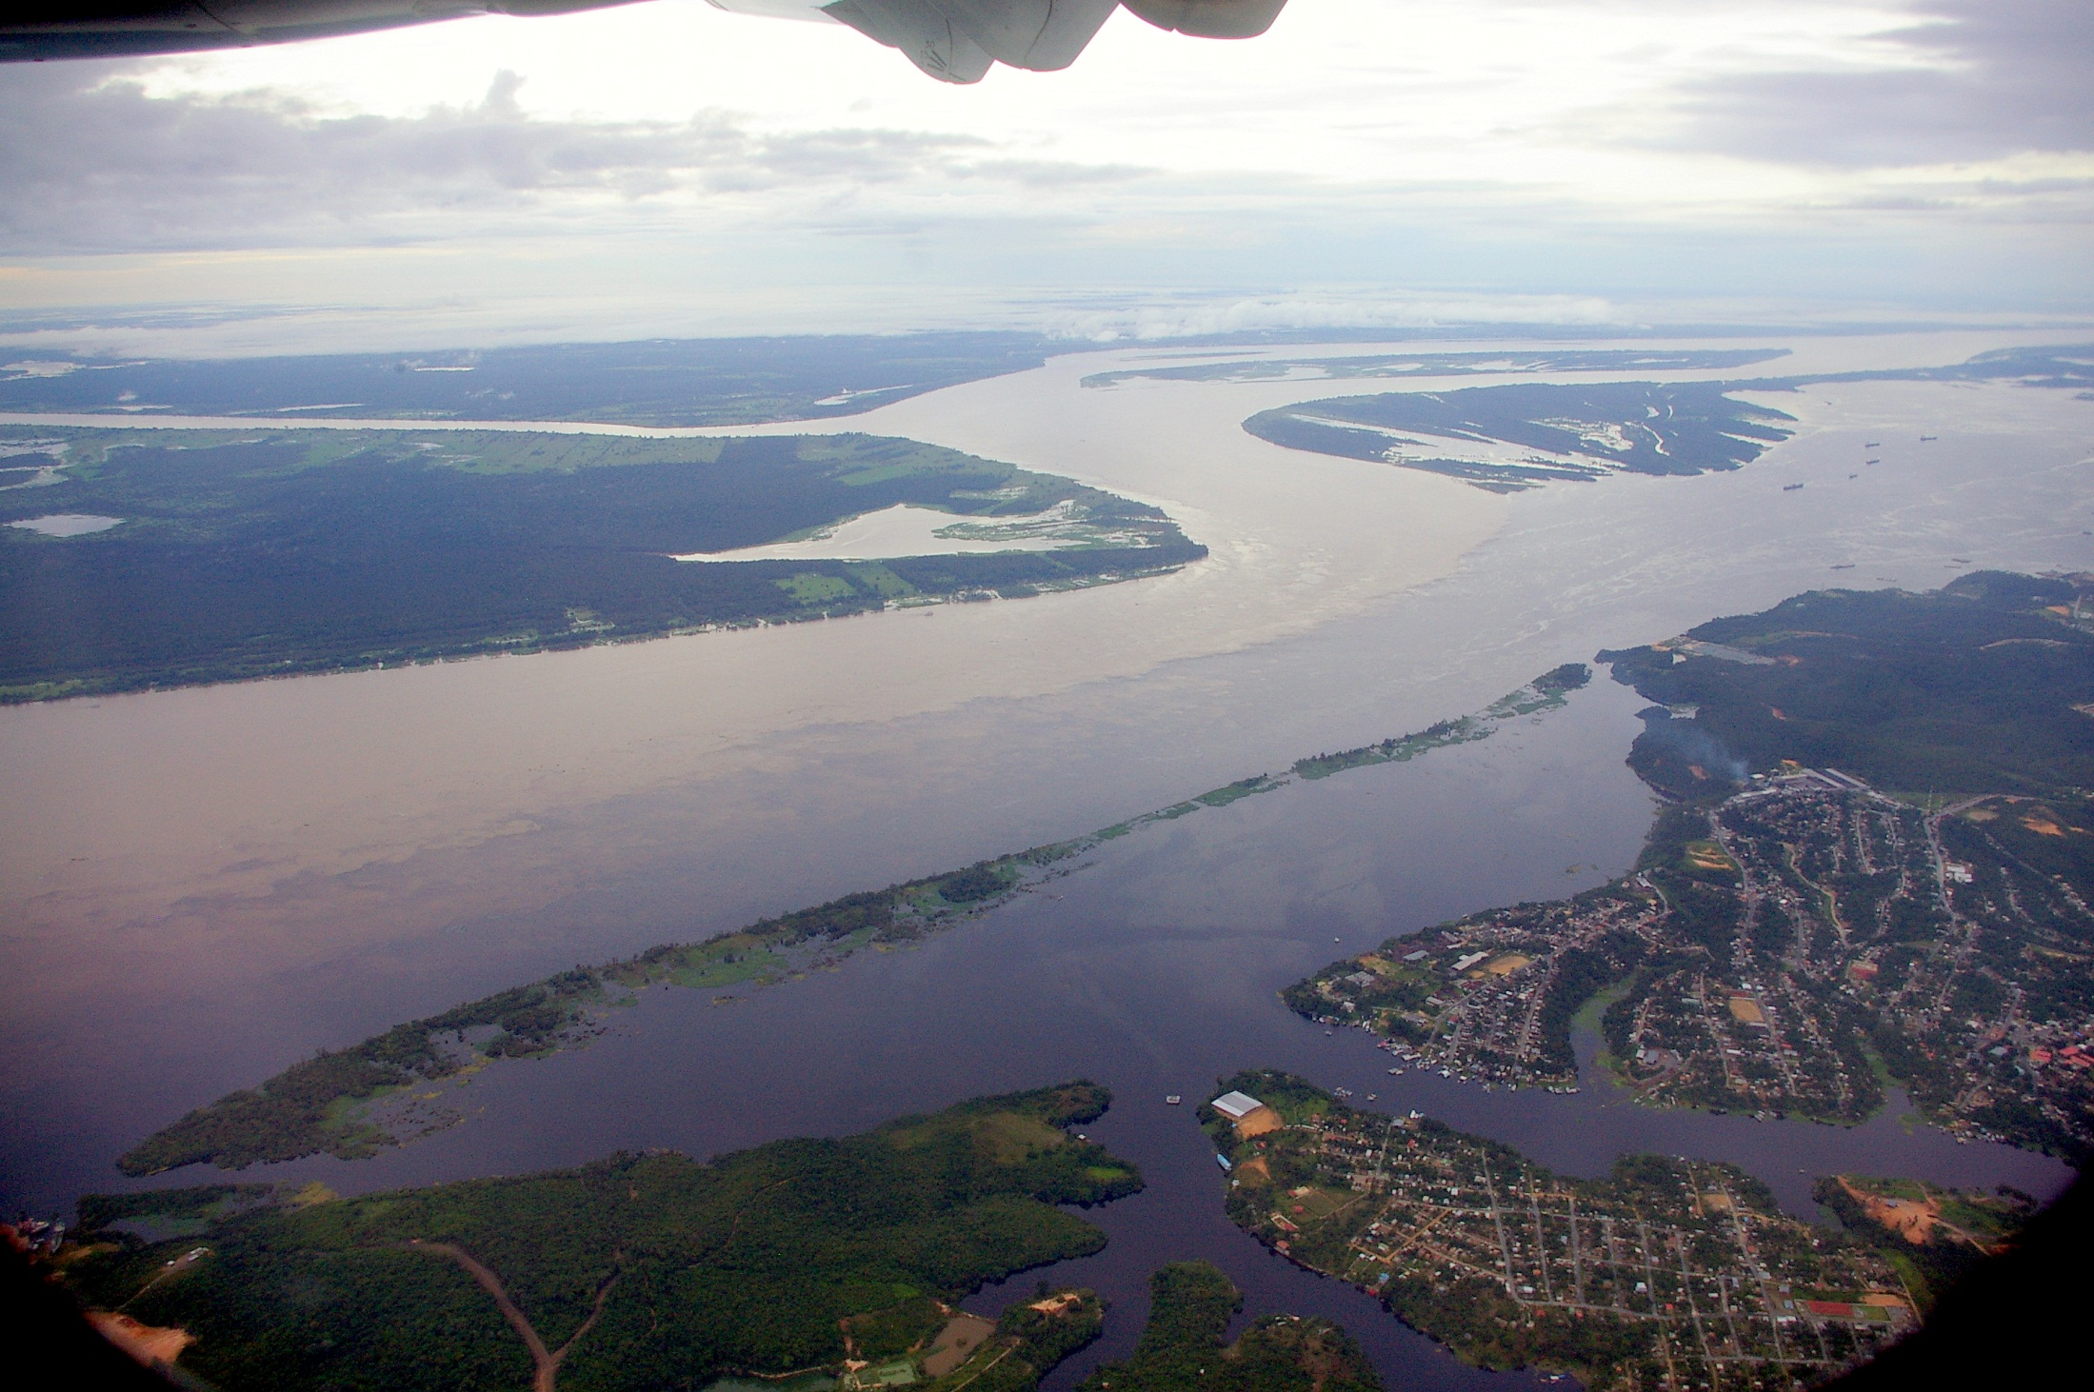
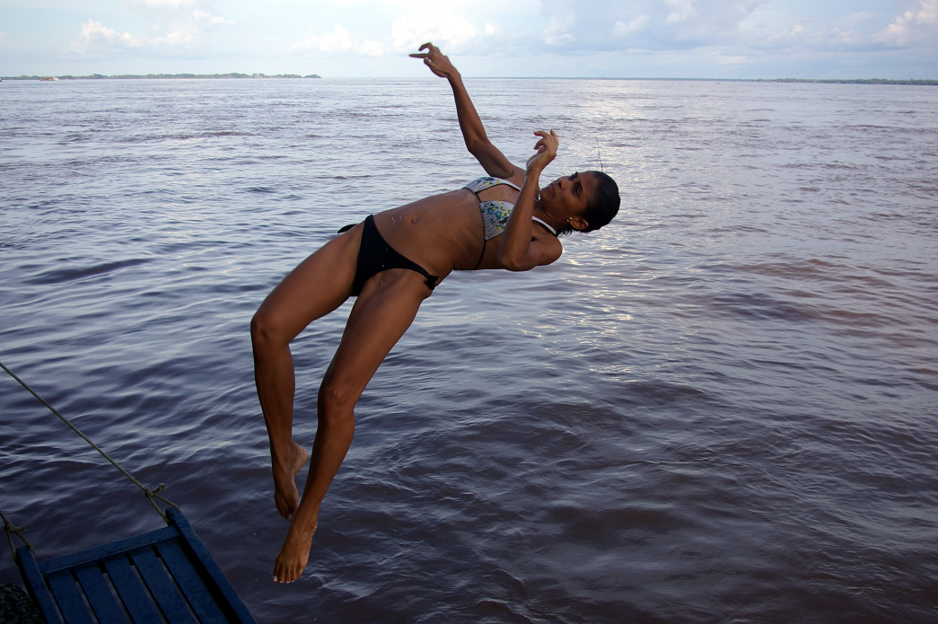
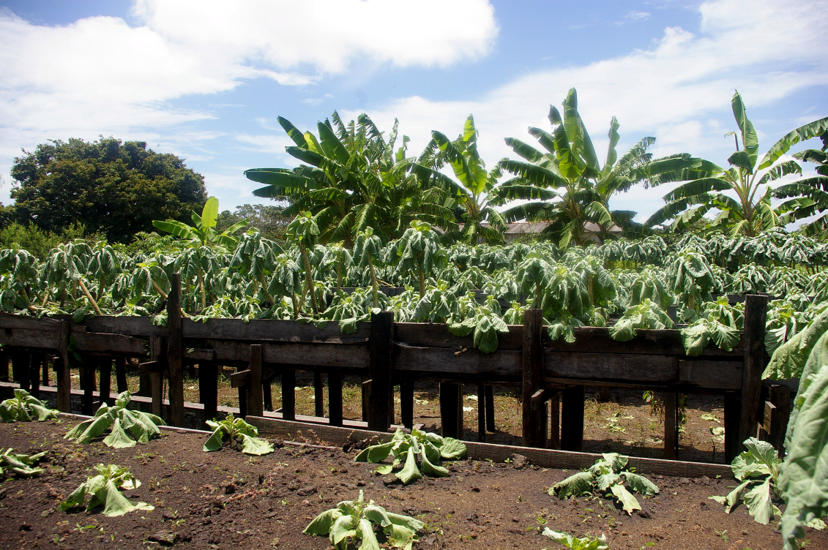
How much are ecosystem services worth?

Slide 25
Intertemporal Calculations
Appropriate Discount Rates
Long-term (intergenerational) benefits
Calculating Risk vs Uncertainty (knowable vs unknowable)
Decision-making under uncertainty
Prosperity: preservation vs development

Slide 26
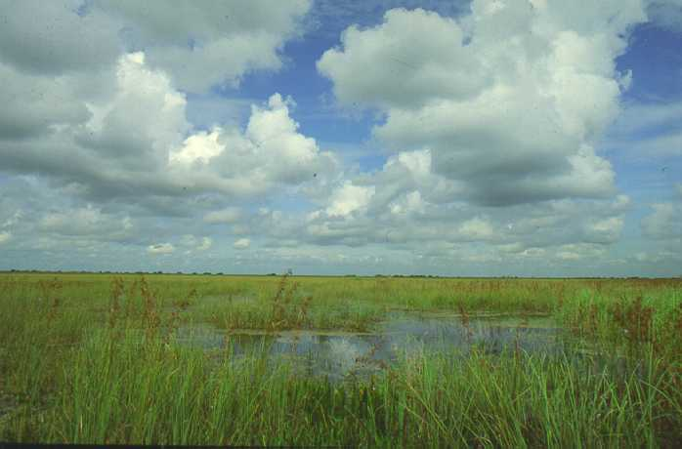
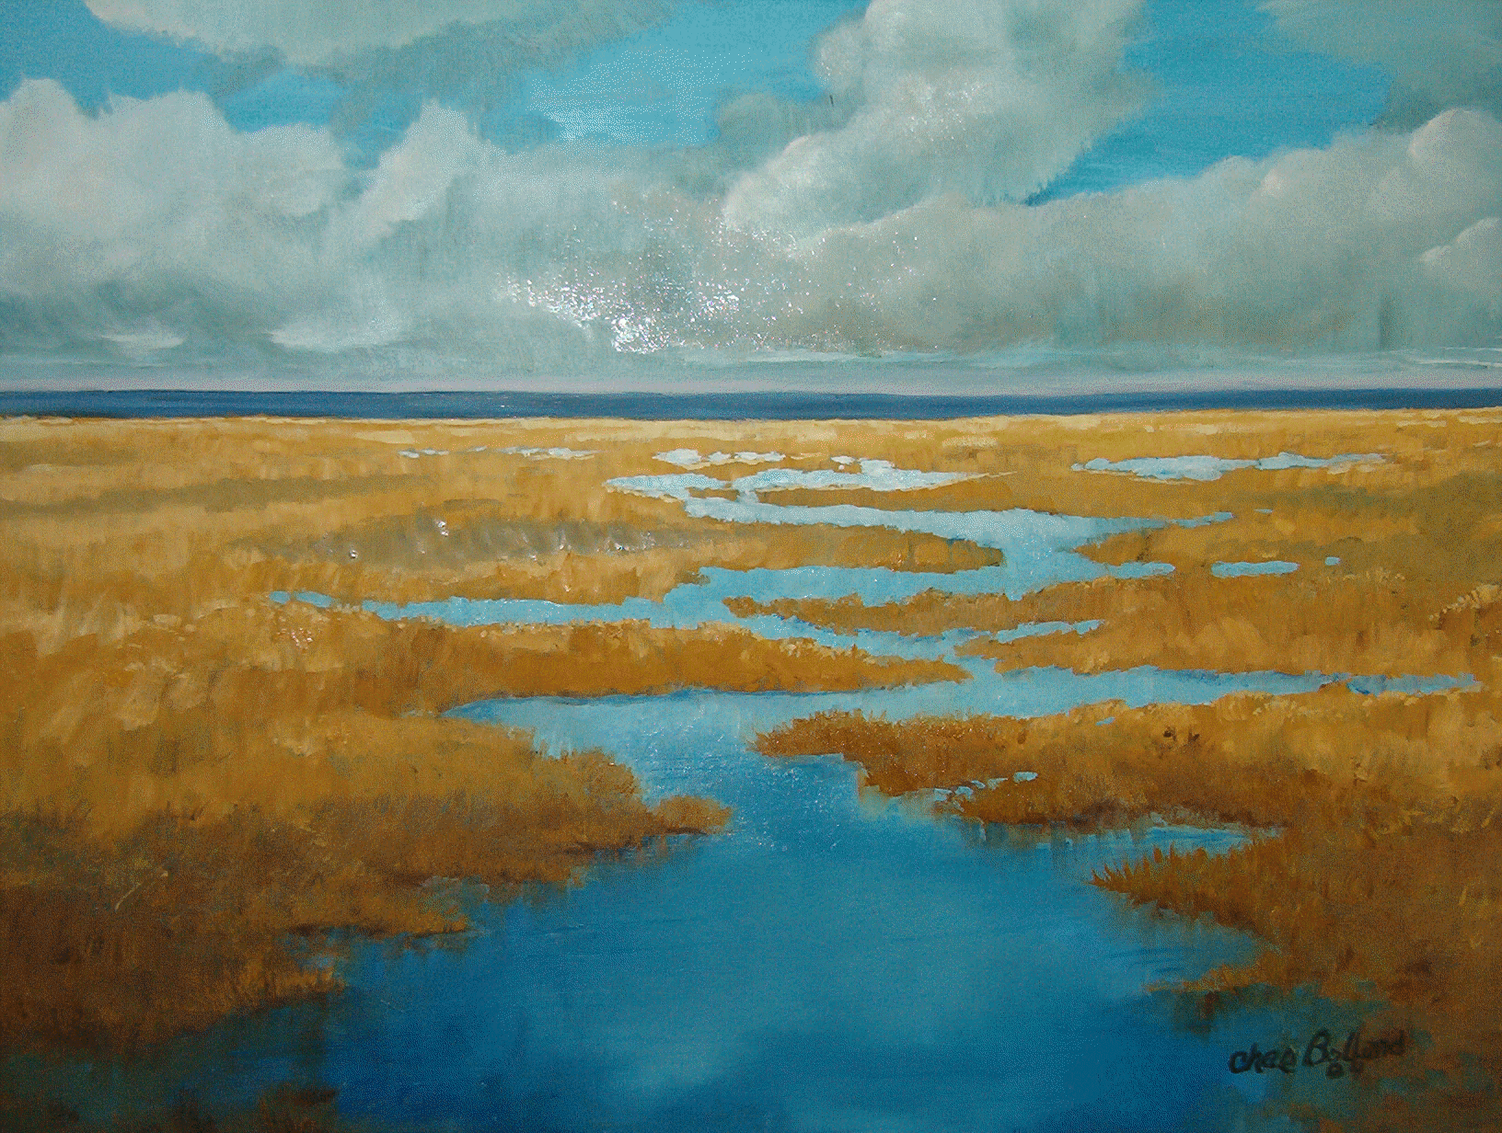
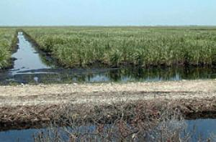
Everglades: A river of grass How should decision-makers 100 years ago consider the value of this to us today?

Slide 27
FIELDS OF CANE United States Sugar's Clewiston sugar cane refinery. A $1.75 billion deal to sell land and assets to Florida was reduced to 72,800 acres, in separate parcels, for $536 million.

Slide 28
Inter-Group Differences (Interest Groups)
Environmental/Cultural - Luxury Goods?
Income elasticity of demand – rich vs poor?
Interpersonal Comparisons of Utility – mine vs yours?
Marginal Utility of preservation vs development – rich vs poor?
Inter-Regional Rivalry of “Shared Resources”
Inter-Generational Rivalry
Interest Group Political Rivalry

Slide 29
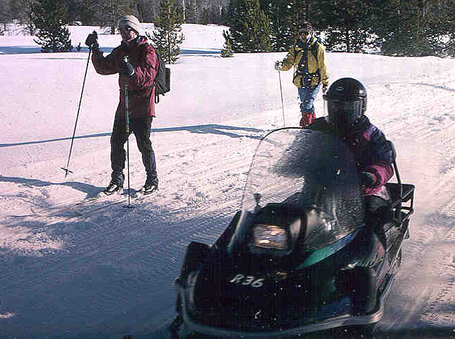
Diverse interests, even among those seeking recreation

Slide 30
Income Elasticities: Environmental/Cultural Goods
Income elasticity of Demand – Sensitivity of demand for environmental and cultural services to income levels.
Claims of environmental services as “luxury” goods (demand rises more than proportionally with increases in income).
Similar concerns for cultural goods & services.
Examples: Property in clean areas more valuable and hence poor get shut out.

Slide 31
Interpersonal Comparisons of Utility
Scarcity creates Opportunity Costs of Sustainable projects which mean tradeoffs of non-market goods & services. How do you measure “intensity” of want/desire/demand of those with different preferences.
Do you want “A” more than I want “B”?
Need to estimate a social “net benefit” requires some sort of aggregation of individual costs/benefits.

Slide 32
Income (Wealth) Considerations in Preservation vs Development Decisions
Is the evaluation of the tradeoffs between preservation and development affected by income (wealth) considerations?
Inter-regional differences
Intra-regional differences
Inter-generational differences

Slide 33
Inter-Generational Rivalry
Conflicts arise when benefits and costs accrue to different age groups within a society.
Conflicts arise when benefits and costs accrue at different times (current benefits, future costs or current costs, future benefits).
Examples: Drain Everglades – present benefit but future cost

Slide 34
Cultural Conflicts
Social Objectives: Wealth (GDP) vs Development (HDI) vs Happiness (new measures being developed).
Implications of objective choice.
Tradition: Cultural roots that place non-economic values on certain activities.
Examples:
Latin America – US West

Slide 35
Restoration of Natural Water Flow in the Florida Everglades – A Case Study

Slide 36
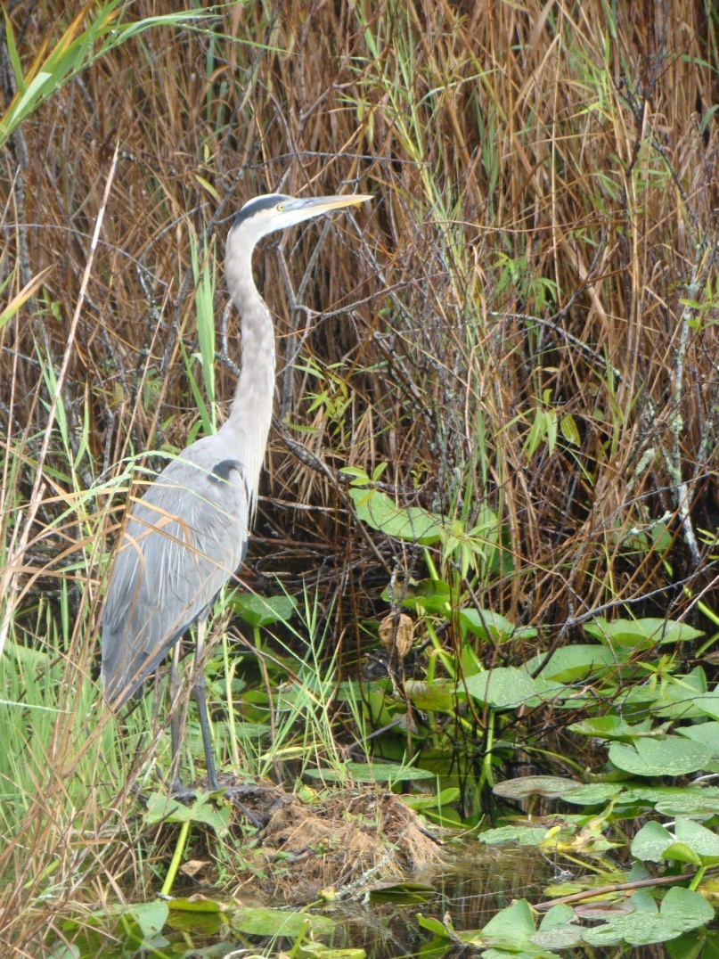
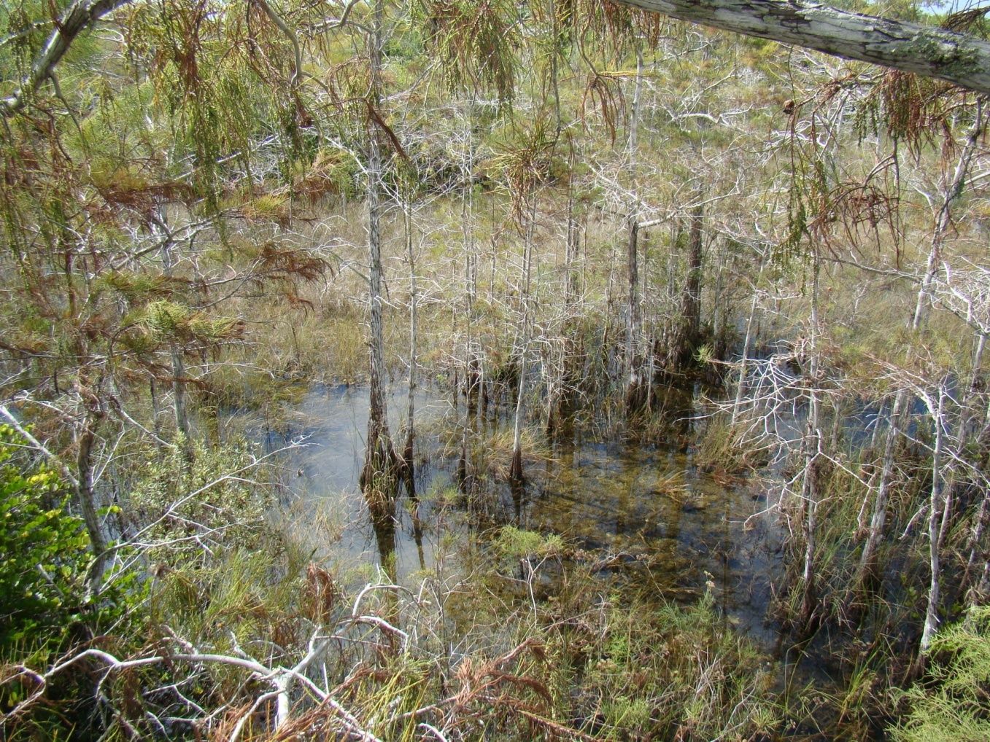
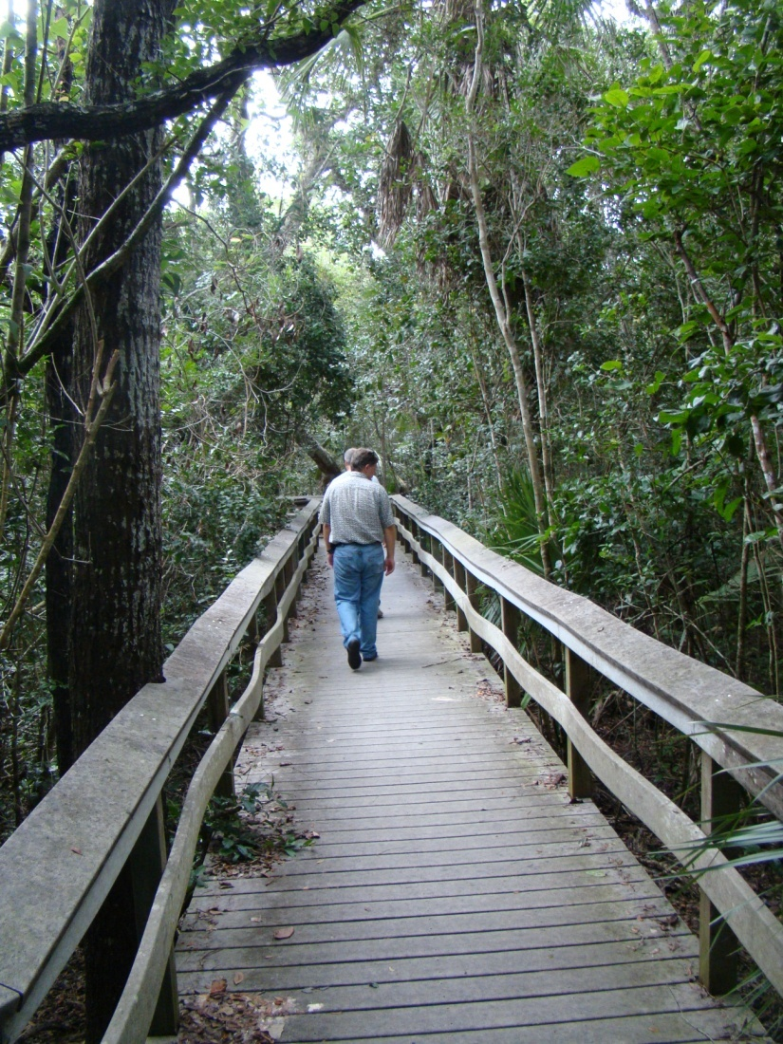
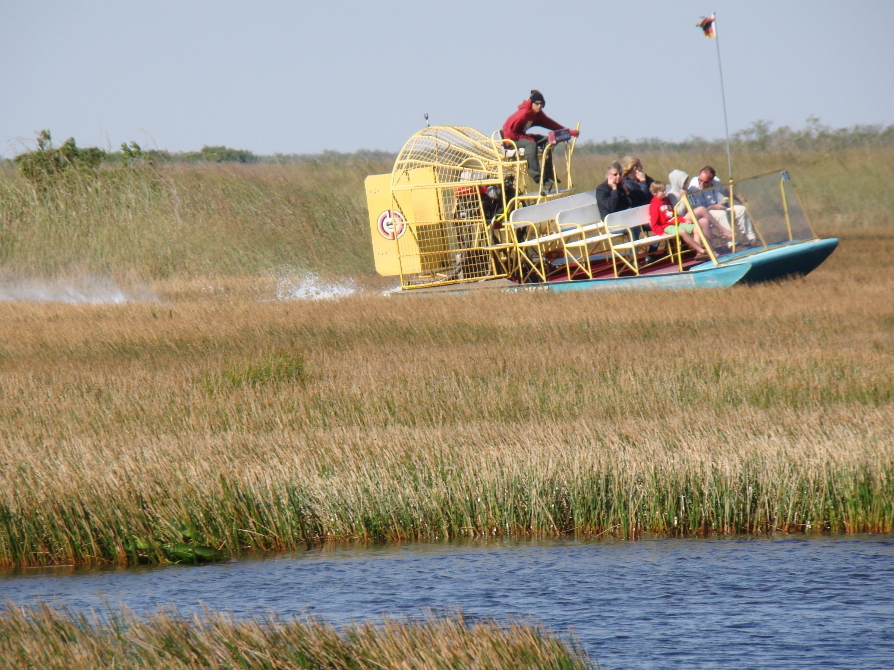

Slide 37
Everglades Restoration will be economically as well as environmentally sustainable
The country—and the state of Florida in particular—stand to gain significant economic growth and new job creation as a result of Everglades restoration, according to an economic study commissioned by the Everglades Foundation.
Everglades restoration efforts under the Comprehensive Everglades Restoration Plan (CERP) are projected to produce more than $46 billion in benefits to 16 South Florida counties and create 442,664 jobs over 50 years.

Slide 38
Benefits of Everglades Restoration
Among the benefits of Everglades restoration, according to the report:
•Protection of Water Supply: Enhanced availability of freshwater, decreased costs of
alternative water supplies
•Enhanced Value of Real Estate: Increased property value due to the quality of water
in waterways and groundwater
•Boost to Tourism and Recreational Sector: A restored ecosystem and improved wildlife population allows for additional recreational opportunities for residents and visitors
•Recovery of Fishing Industry: Both recreational and commercial fishing industries experience a significant rebound with the protection and enhanced quality of water and fish habitat
•Improved Wildlife Populations and Hunting Opportunities: Restoring habitat allows for increases in wildlife populations

Slide 39
Economic Benefits of Restoration
Summary of Ecosystem Services Valuation of Everglades Restoration
Service Benefits Net Present Value of Restoration
Groundwater Purification $13,150,000,000
Real Estate $16,108,000,000
Park Visitation $ 1,311,588,000
Open Space $ 830,700,000
Recreational Fishing $ 2,037,000,000
Commercial Fishing $ 524,100,000
Wildlife Habitat & Hunting $12,539,900,000
Total Value of Services $46,501,288,000
Initial Investment in Everglades restoration: $11,500,000,000
Benefit-to-Cost Ratio: 4:1
Source: Measuring the Economic Benefits of America’s Everglades Restoration, Mather Economics, Roswell, GA., Bobby McCormick, PH.D., Principal Investigator, Study Prepared for the Everglades Foundation

Slide 40
Impact of Restoration on Local Employment
Sector Incremental Jobs
Commercial Fishing 6,798
Recreational Fishing 36,868
Residential Construction & Real Estate Services 273,601
Tourism (Lodging, Eating & Drinking, Transportation, Retail,
Entertainment) 48,552
Agriculture (3,724)
Wildlife Habitat & Hunting 80,569
TOTAL 442,664
Source: Measuring the Economic Benefits of America’s Everglades Restoration, Mather Economics, Roswell, GA., Bobby McCormick, PH.D., Principal Investigator, Study Prepared for the Everglades Foundation

Slide 41
Land Use Conflicts in Yellowstone: A Case Study in Sustainability

Slide 42
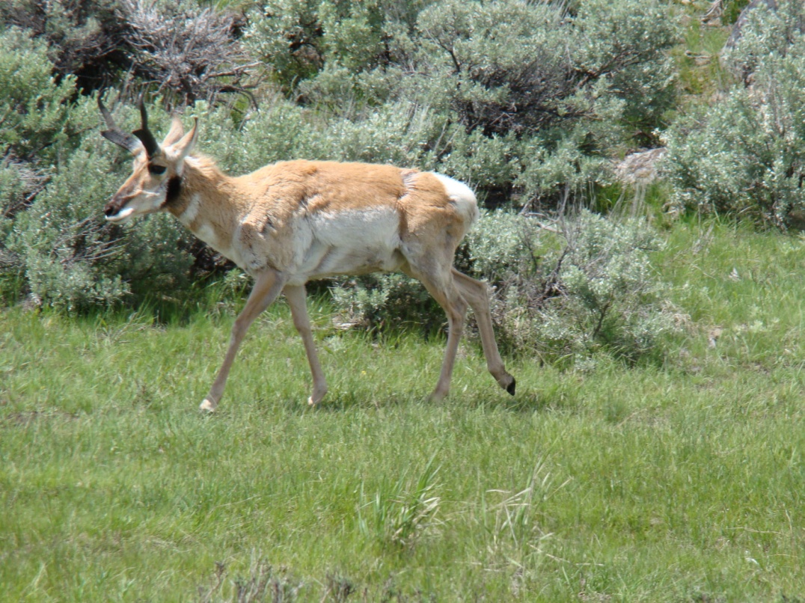
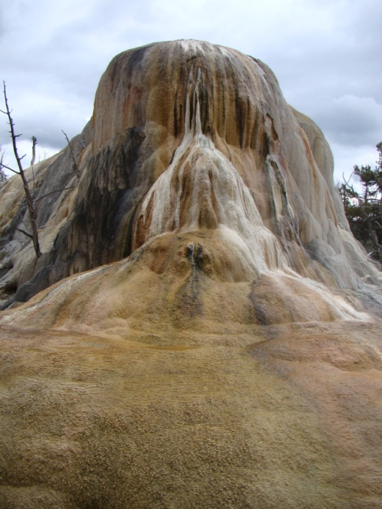
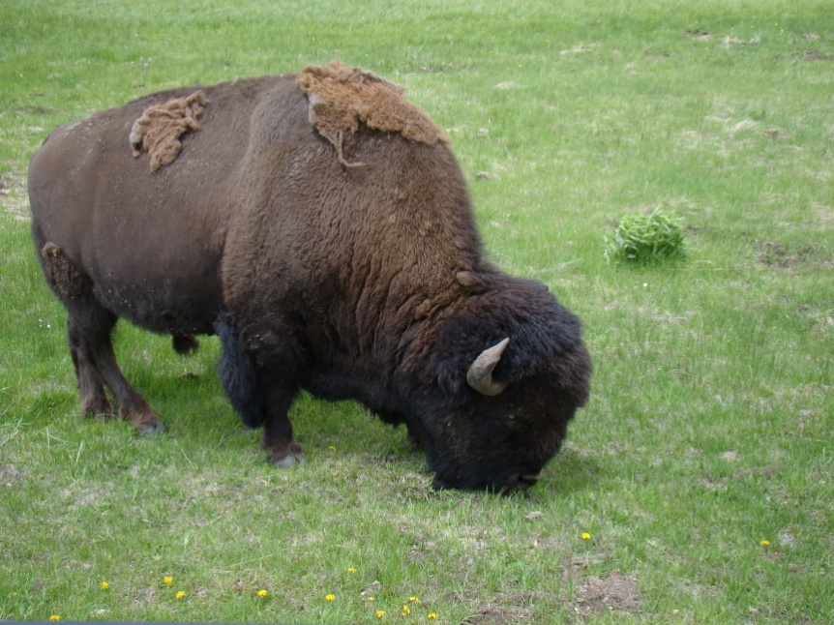
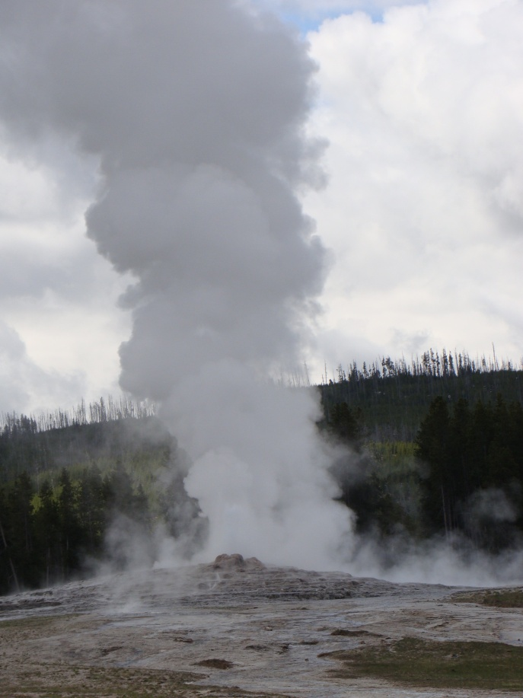
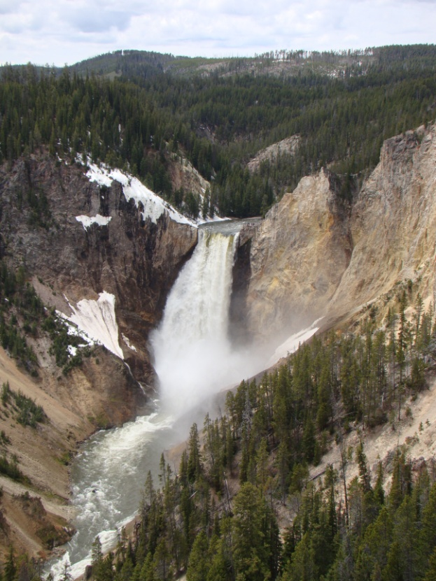
Yellowstone: America’s First National Park

Slide 43
Land Use Conflicts in Yellowstone: A Case Study in Sustainability
1. Bison roaming onto public land in winter in search of food
2. Endangered species protection of wolves in GYE and loss of domestic livestock
3. Use restrictions of park; especially in winter (snowmobiles)
4. Bio-prospecting in areas unusual geothermal features
5. Fire management

Slide 44
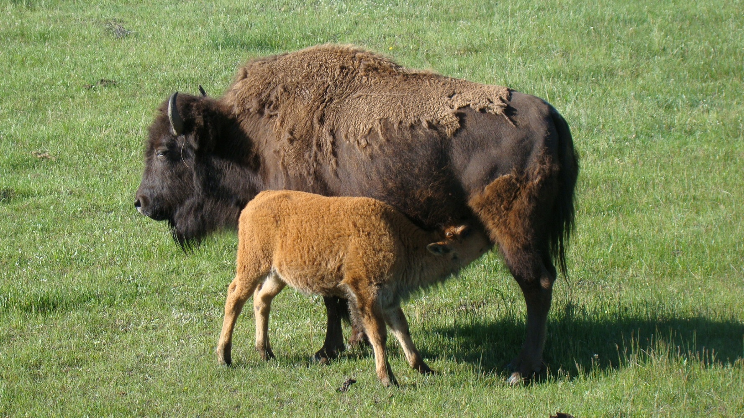
Bison Roaming onto Public Land
YNP Bison herd is genetically unique, but many carry brucella abortus, which can be transmitted to livestock.

Slide 45
Wildlife vs Livestock Brucellosis in GYE

Slide 46
Hazing Bison Back into YNP

Slide 47
Brucellosis: an infectious disease caused by contact with animals carrying the Brucella bacteria.
Brucella can infect bison, elk, cattle, sheep, deer, and pigs. The bacteria can spread to humans if they come in contact with infected meat or the placenta of infected animals, or if unpasteurized milk or cheese is consumed.
Brucellosis is rare in the United States, with approximately 100 - 200 cases each year.
People working in jobs requiring frequent contact with animals or meat -- such as slaughterhouse workers, farmers, and veterinarians -- are at high risk.
Symptoms - brucellosis may begin with flu-like symptoms such as:
Fever Abdominal pain Back pain
Chills Excessive sweating Fatigue
Headache Loss of appetite Joint pain
Weakness Weight loss
Classically, high fever spikes occur every afternoon. "Undulant" fever derives its name from this up-and-down fever.
The illness may be chronic and persist for years

Slide 48
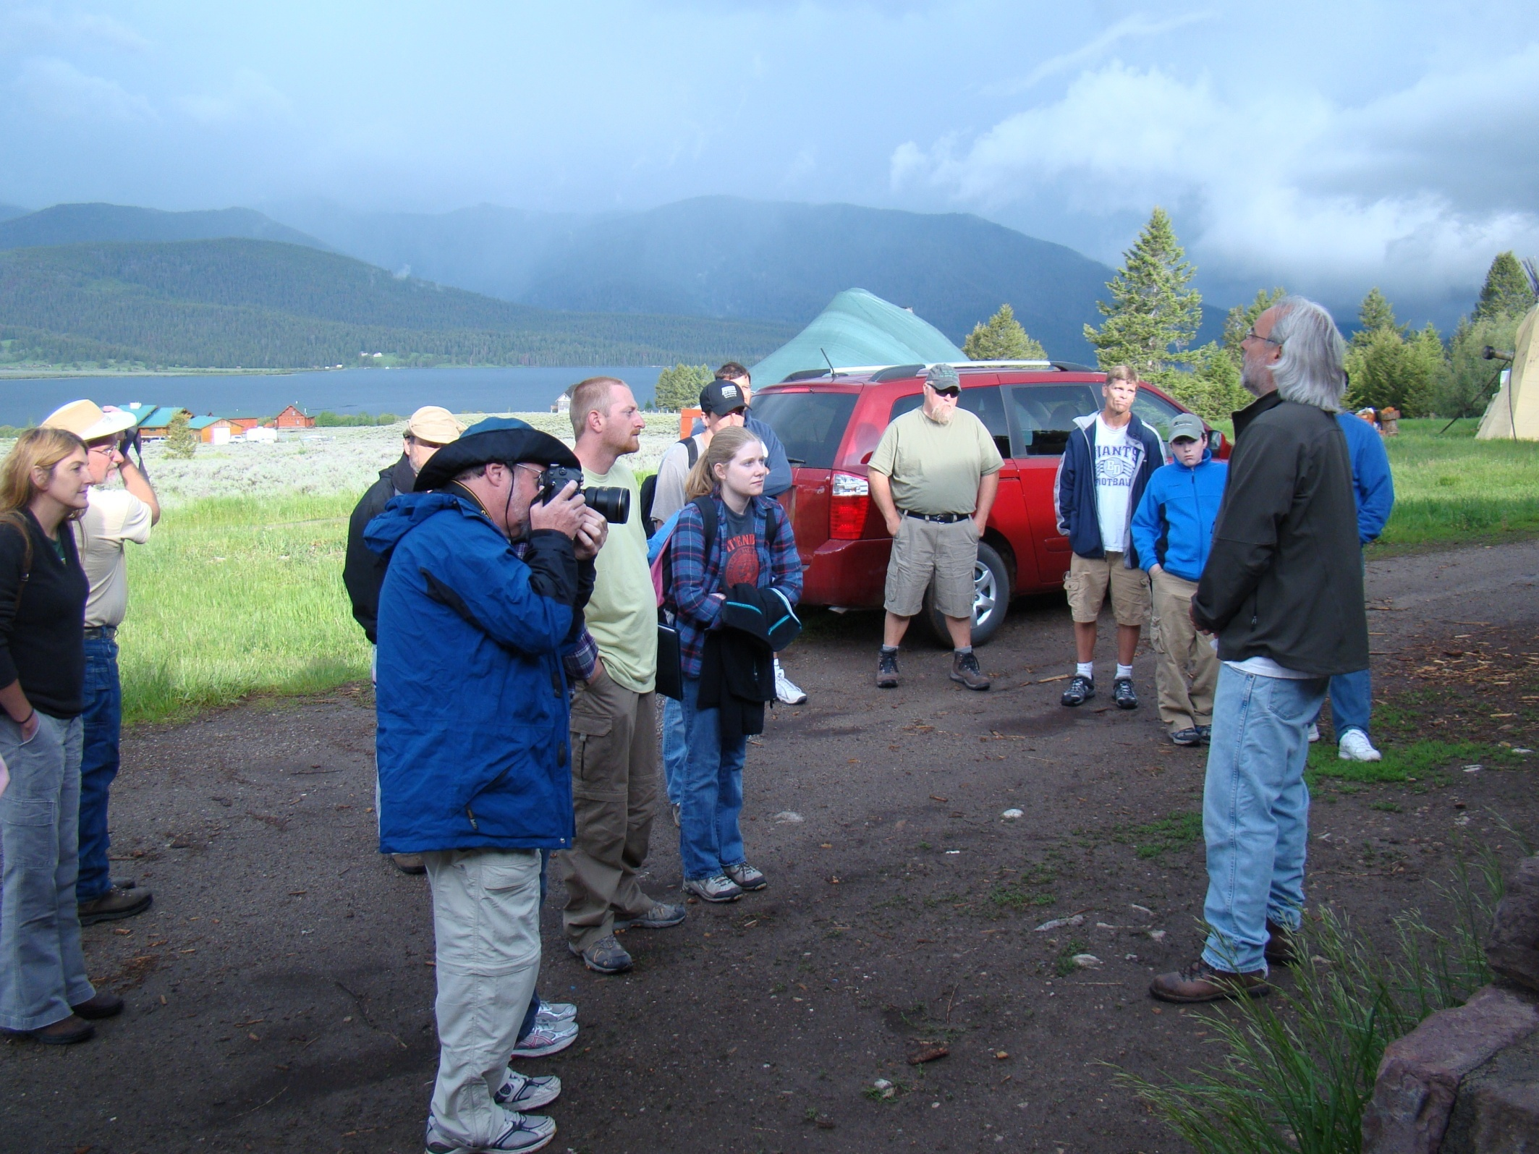
Conflict: Rancher’s property rights
Wildlife carrying brucellosis roaming onto private land to feed during harsh winter months puts livestock at risk. Land use policies in the GYE put environmentalists and ranchers in conflict.

Slide 49
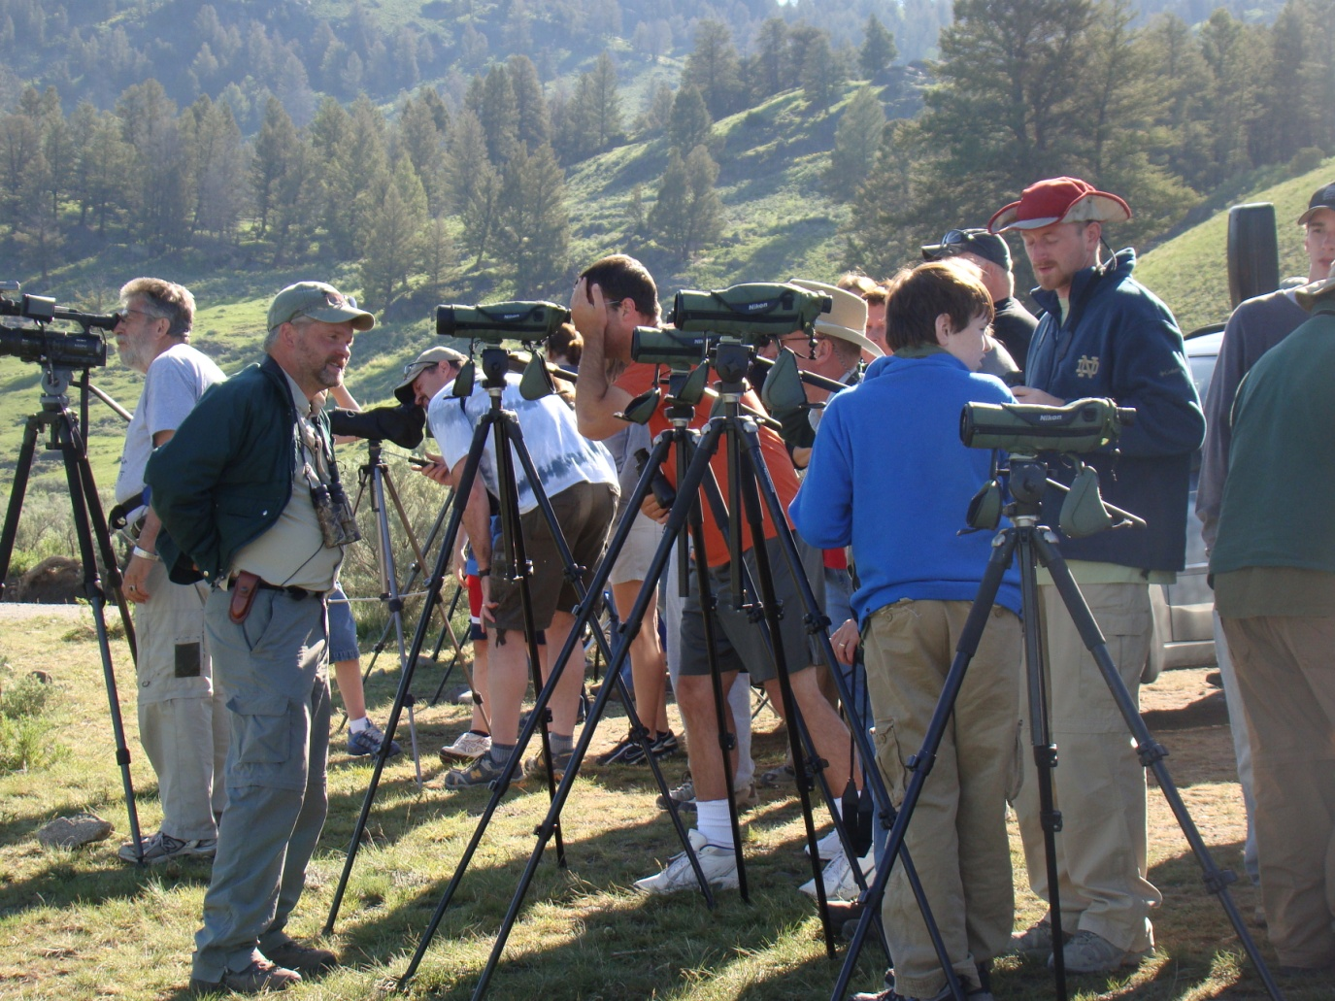
Wolves in the Greater Yellowstone Ecosystem Wolves were removed from the ecosystem by the 1930’s but were brought back in 1995. ecosystem reasons tourism impact on ranchers

Slide 50
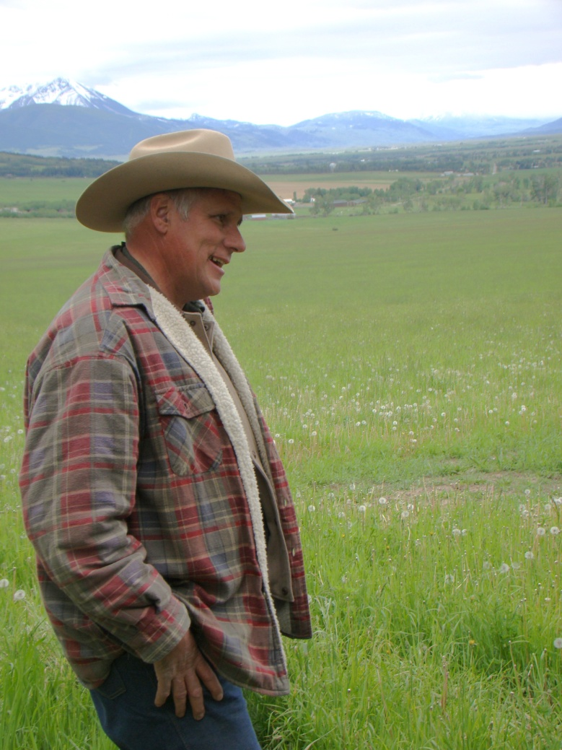
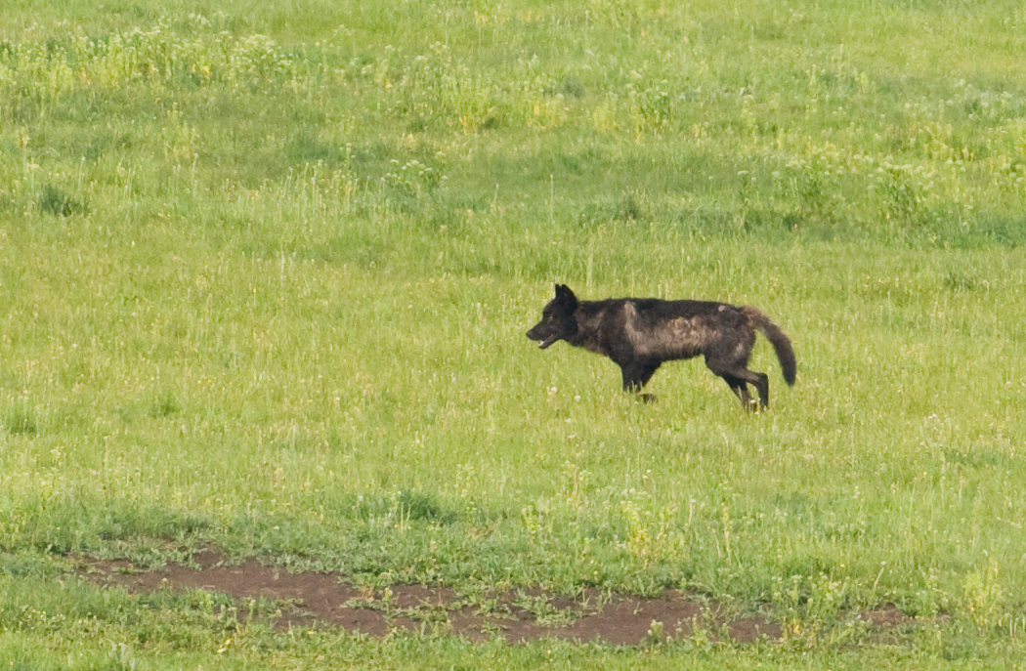
Endangered Species Protection of Reintroduced Wolves
Wolf packs have moved off YNP into the GYE and feed on sheep and calves on private land. Protection keeps ranchers from effectively protecting their livestock.

Slide 51
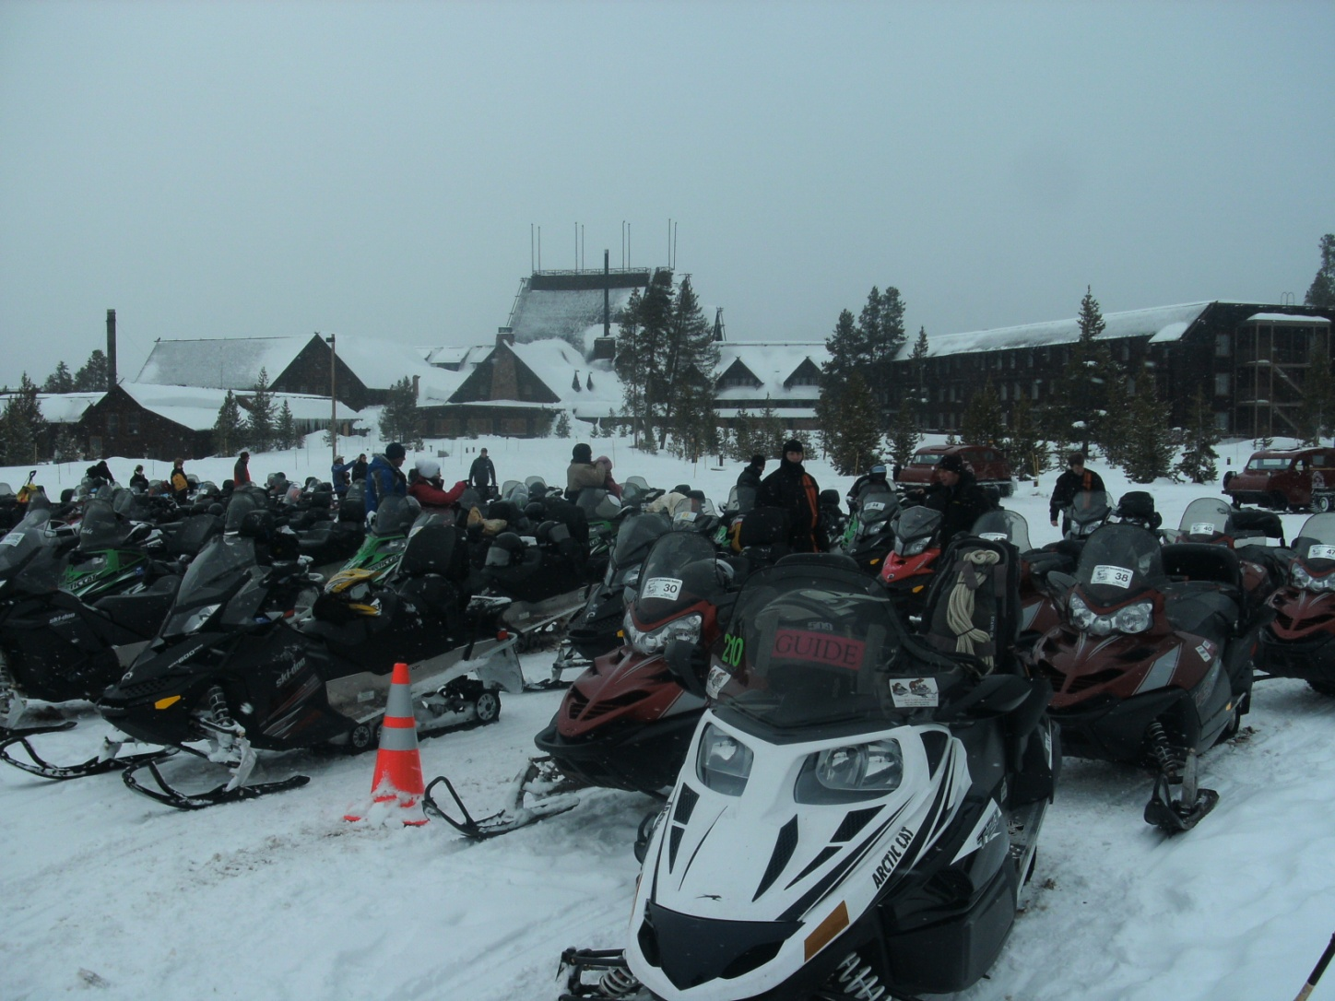
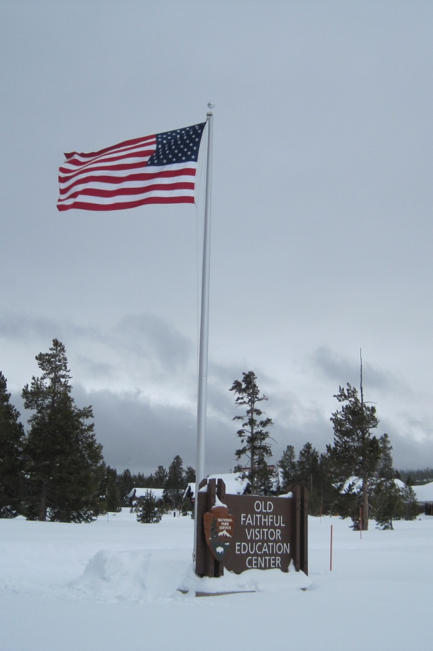
Winter Use Restrictions (Snowmobiles)
History of winter use litigation. National Park Service mission and goals. Conflicts between environmental and economic factors.

Slide 52
Conflict: Gateway Communities, Tourists, and Environmentalists
Environmentalists want sever restrictions on use of the park in the winter.
pollution from vehicles
impact on wildlife during stressful winter season

Slide 53
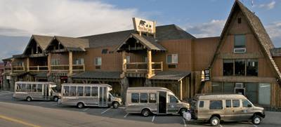
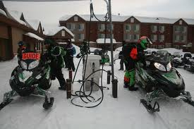
Conflict: Gateway Communities, Tourists, and Environmentalists
Gateway communities need the economic impact of visitors longer than the 3 month summer tourist season to remain viable.
economic survival of small gateway community
ability to serve summer tourists

Slide 54
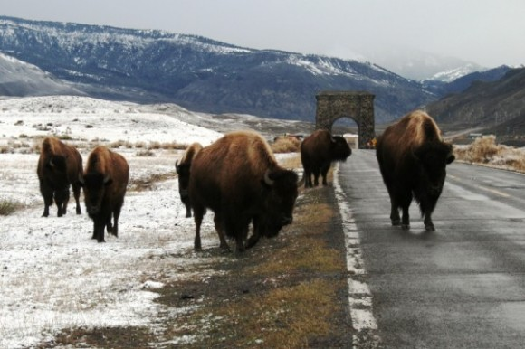
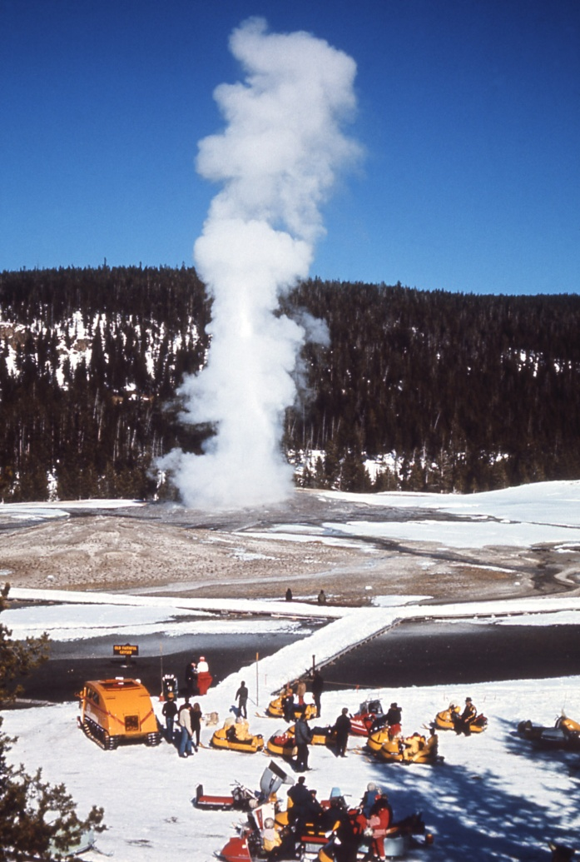
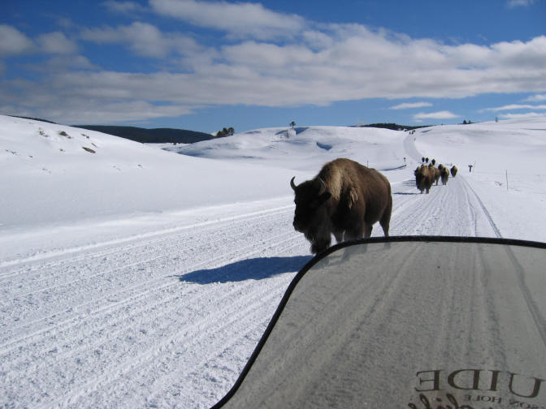
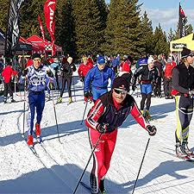
Conflict: Gateway Communities, Tourists, and Environmentalists
Tourists want access to the park in during the winter months.
wildlife winter vistas winter sports

Slide 55
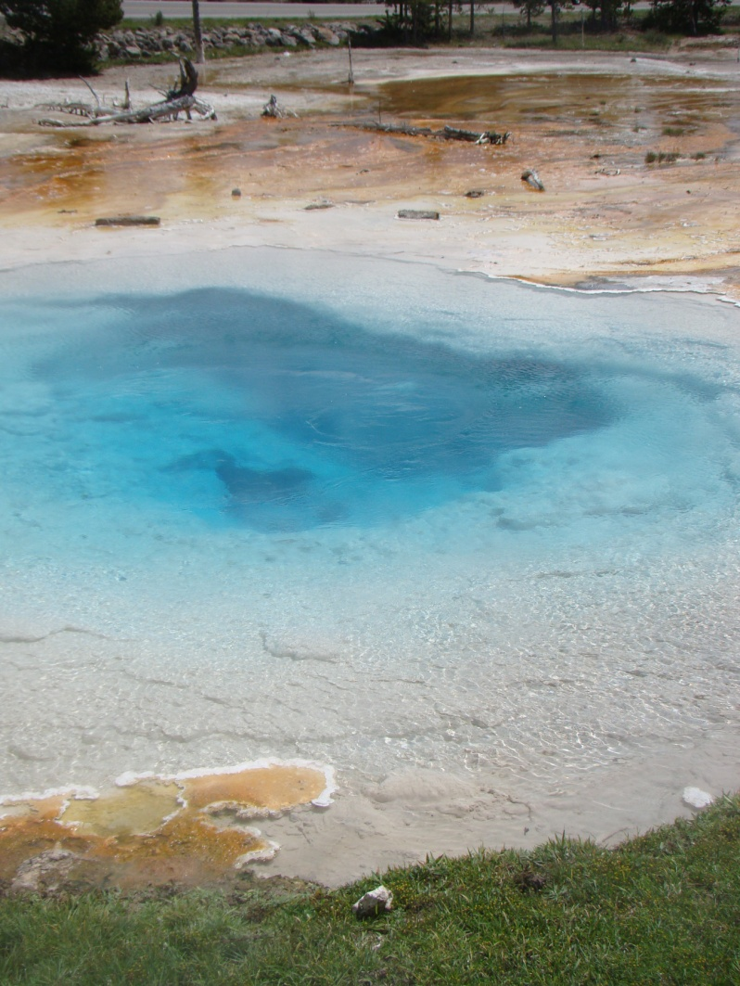
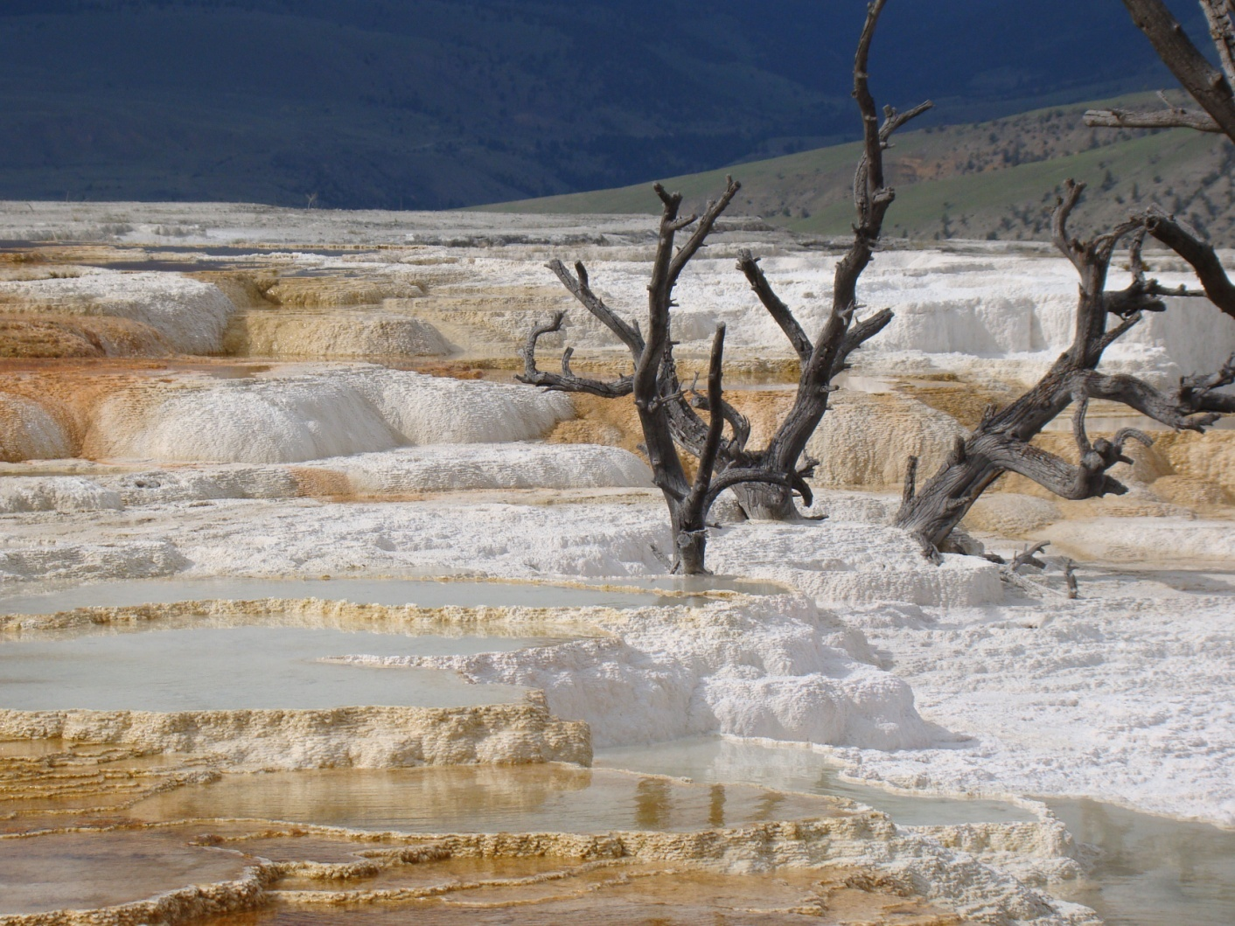
Bioprospecting in Geothermal Features
Geothermal features are home to multitude of thermophyles that have potentially great commercial uses.

Slide 56
Bio-prospecting Conflict
Issue of access to YNP’s sensitive geothermal features to academic or commercial researchers, pits certain environmentalists against those who wish to utilize the genetic characteristics of the thermophyles found there.

Slide 57
ECSLED in Greater Yellowstone Ecosystem
History of Conflicts
Role of Courts and Judges
Efforts of Gateway Community (West Yellowstone, MT)
Creation of the Yellowstone Studies Center
* Community Diversification
* Bringing the Interests Together

Slide 58
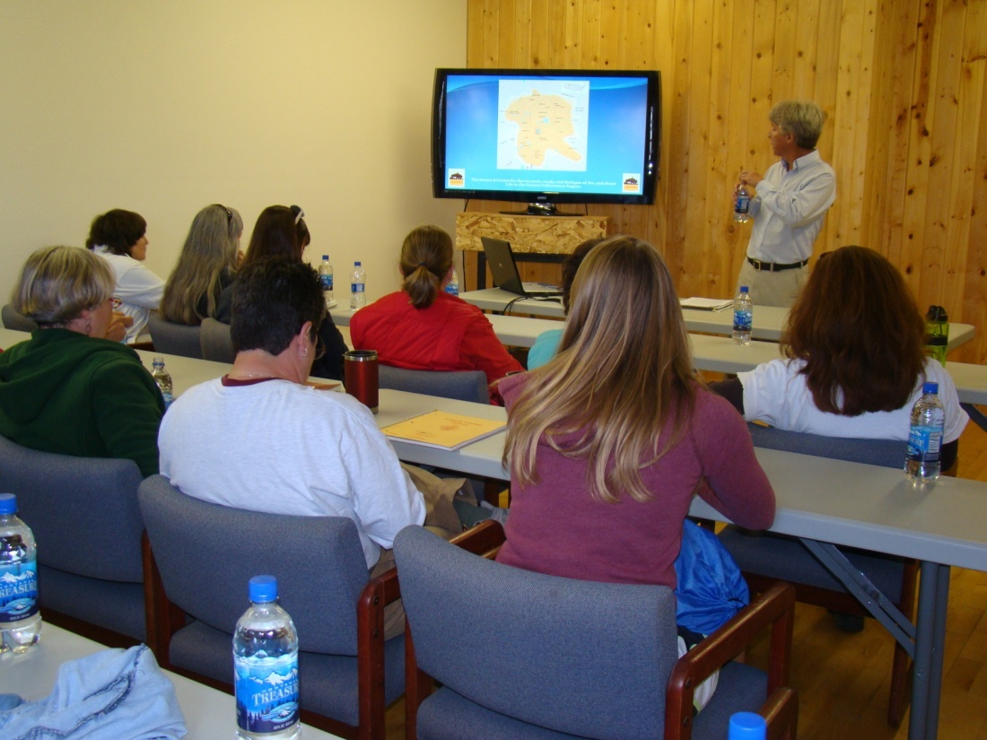
Yellowstone Studies Center

Slide 59
Florida Keys Marine Sanctuary

Slide 60
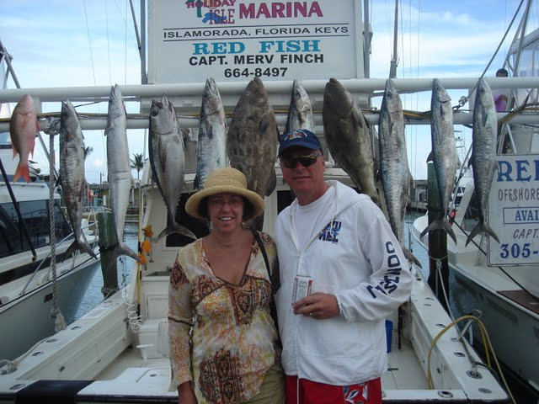
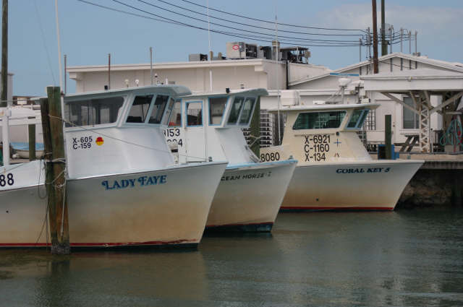
Conflict over Public Water Use: To fish or not to fish
Local economy vs Preservation (Conservation?)
*Issue is parallel to snowmobile use for West Yellowstone, MT

Slide 61
Similar Conflicts – Very Different Geography
Life/Death of a small Gateway Community
What would this mean for sustainability of recreational use of Yellowstone National Park?
VS.
Continued economic development of a “developed” economic zone
ECSLED pedagogy similar

