Slide 1
A review of the 2016-17 campus climate survey

Slide 2
The Survey
Developed by CampusClarity/EverFi
Host of the online training module for sexual misconduct
First implemented in fall 2015
Survey disseminated in fall of 2016 to 15, 518 students
931 surveys started
662 surveys completed
Abandoned- 269
Via Tigger button- 20
Skip Logic
Response numbers vary significantly
Notes:
Notes:
These are the totals. Note they could have been triggered/abandoned at anytime. Going deeper into the results you can see where the drop off was: i.e. was it a certain question that may have triggered the person.
Define Triggered/Abandoned

Slide 3
Overview:
Focus on five (5) key areas:
Where did reported incidents occur?
Who are the reported perpetrators?
When students were assaulted, were they able to consent?
Who did students disclose their experience with?
Why do victims refrain from reporting?
Notes:
Notes:
These were the more basic questions, the others dove a little deeper into the assault: when did the assault occur, what type of assault was it (forced touching, oral, penetration to anal, penetration to vagina), how did the person have unwanted contact (by force, by threat, unable to consent).
These results are available to review; however, since the online training module was launched in July of 2015- this is a good place to get a baseline of how we are doing in terms of our education and prevention strategies.

Slide 4
Where did reported incidents occur?

Slide 5
Where did the incident occur? (32 Responses)
Notes:
Assessment: The survey shows that 40.6% of the victims were assaulted off campus, but within the community/Terre Haute.

Slide 6
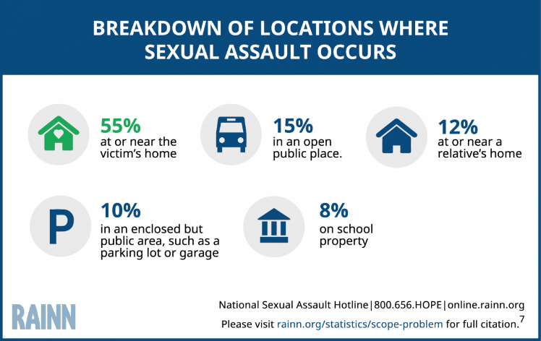
Comparison to national statistics: The Majority of Sexual Assaults Occur At or Near the Victim's Home (i.e. off campus)
Notes:
This reinforces the numbers from the previous slide.
*I would also add, many of our students do not know what is or isn’t campus property. The clarification of campus or off campus is determined if university officials are involved.

Slide 7
Recommendations:
Develop a SAFE Ride program
Provide students with community resources: public transportation
Partner with the local bar owners to post posters, coasters, or information that can serve as bystander intervention or general assistance
Party Smart Sycamores with Student Health Promotion
Partner with University Police Department to provide general safety information and tools (example: safety whistles) and instructing regular self defense classes.
Increase RAD self-defense instructors
Notes:
Action:
We need to do a better job informing our students on the resources available to keep them safe both on and off campus. One example to assist students who are off campus and need a safe ride back to campus or their residence is to offer a SAFE Ride program where students can get a free ride back to campus from whatever location they are at.
We can also partner with local bar owners to post information on safety resources from the campus and the community. We do this during the Walk,- why not do this year round.
We can also work with campus partners such as the University Police Department to provide students with general safety information and safety whistles, as well as offering self defense classes.
I believe we do a good job of providing resources to students. However, if a student doesn’t see the need in the resource at the moment it is presented- they may not retain it.

Slide 8
Who are the reported perpetrators?

Slide 9
Was the person a student, professor, or other employee at this school? (26 Responses)
Notes:
Assessment: More than half of the responses indicate that the perpetrator is a student, faculty, or staff member.
The issue with this question is the vagueness. There are substantial differences between student, professor, or other employee. This would be an area I would see if we could break down further for future climate surveys.

Slide 10
Who was the person/people who had unwanted sexual contact with you during the incident? Please select all that apply. (31 Responses)
Notes:
Assessment: According to RAINN, statistics show that 7 out of 10 rapes are committed by someone the victim knows. The survey shows that over 60% of the assaults on ISU’s campus were by someone the victim knew.

Slide 11
Comparison to national statistics: Perpetrators of Sexual Violence Often Know the Victim

Slide 12
Recommendations:
Provide Title IX training for students annually rather than once in their entire journey with ISU.
Include personal questions such as the ones in the climate survey, in the annual modules so that students are less likely to skip through the modules.
Continue to market resources available to students through a variety of mediums
Provide workshops to help students identify what sexual assault is and how to report it.
Implement educational programming that dispels the myths about sexual assault (strangers are the perpetrator, being drunk causes rape, what victims wear causes rape, etc.).
Notes:
We need to rethink our plan for addressing sexual misconduct through prevention and education.
We need to have more consistent training throughout the year(s). Currently, students are only required to go through It’s On Blue training as first time Sycamores, while there are programs addressing sexual misconduct prevention and intervention offered sporadically though the university, the required and intentional training is only offered once during a student’s ISU career.
We could work with Campus Clarity or create an ISU specific module (Back to Blue) that serves as a refresher course while also incorporating survey questions to continuously assess the campus while they are refreshing their minds. If there are personal questions such as the ones in the climate survey in the modules, students are less likely to skip through the modules.
Option B: An acknowledgement Statement
Prior to registering for classes, the policy would appear and they have to scroll to the bottom select, I understand, prior to proceeding.
In addition, Title IX needs to continue to market resources available to students through a variety of mediums: website, social media, the mobile app, and etc.
According to RAINN, statistics show that 7 out of 10 rapes are committed by someone the victim knows. The survey shows that over 60% of the assaults on ISU’s campus/community, were by someone the victim knew. Training and education needs to focus on three primary things:
Defining Sexual Misconduct
There should also be educational programming that dispels the myths about sexual assault (strangers are the perpetrator, being drunk causes rape, what victims wear causes rape, and etc
Encouraging bystander intervention
Step Up
One Love
Teaching students not to rape/assault/ take advantage of others

Slide 13
When students were assaulted, were they able to consent?

Slide 14
Consent Is:
922.5.5 Consent. Consent is a knowing, voluntary, and clear mutual agreement to engage in sexual activity. Consent must be freely and actively given, and communicated by clearly and mutually understandable words or actions to participate in each form of sexual activity. Consent may be withdrawn at any time. Consent to some sexual contact cannot be presumed to be consent for other sexual activity including previous consent or the existence of a current or previous relationship. Silence or the absence of resistance is not the same as consent.
922.5.5.1 Lack of Consent. Lack of Consent means:
a. The person has not given consent; or
b. The person is incapable of giving consent because of mental, developmental, or physical disability; or
c. Force is used or threatened; or
d. The person is incapable of giving consent as a result judgment-inhibiting intoxication without regard to the intoxicant; or
e. The person is not sufficiently conscious to provide consent.
f. The person is not old enough to give consent. In Indiana, any person who has reason to believe that a child is a victim of child abuse or neglect has a duty to make a report to Child Protective Services or to the police.

Slide 15
How many of the people who had unwanted sexual contact with you had been drinking alcohol or using drugs? (4 Responses)

Slide 16
Were you unable to provide consent or stop what was happening because you were incapacitated, passed out, unconscious, blacked out, or asleep? (6 responses)
Notes:
Assessment: Title IX needs to help students understand what consent is and the different forms it comes in. There also needs to be education on the importance of having consent. There might not be any resources but we need to show students that getting consent isn’t a tedious process and won’t impede a relationship.

Slide 17
Recommendations:
Implement educational workshops that teach students about the definition of consent, providing examples of what is or is not consent.
Collaborate with Student Health Promotion to have educational programs about alcohol (and other drug) consumption and how it inhibits a person’s ability to consent, drive, etc.
Party Smart Sycamores
Create and disseminate a consent campaign to raise awareness of what consent is.
Student developed
Notes:
Resources: http://www.nsvrc.org/sites/default/files/saam_2015_what-is-healthy-sexuality-and-consent.pdf
Assessment: Title IX needs to help students understand what consent is and the different forms it comes in. There also needs to be education on the importance of having consent. There might not be any resources but we need to show students that getting consent isn’t a tedious process and won’t impede a relationship.

Slide 18
Who did students disclose their experience to?

Slide 19
Have you told any of your roommates, friends, or family members about the incident? (31 Responses)

Slide 20
Were they notified? (30 Responses)
Administrators, faculty, or other officials or staff
at this school
Were they helpful?
(3 Responses)

Slide 21
A crisis center or helpline, or a hospital or health care center at this school
Were they notified? (30 Responses)
Were they helpful?
(3 Responses)

Slide 22
A crisis center or helpline, or a hospital or health care center NOT at this school
Were they notified? (30 Responses)
Were they helpful?
(3 Responses)

Slide 23
Campus police or security at this school
Were they notified? (30 Responses)
Were they helpful?
(3 Responses)

Slide 24
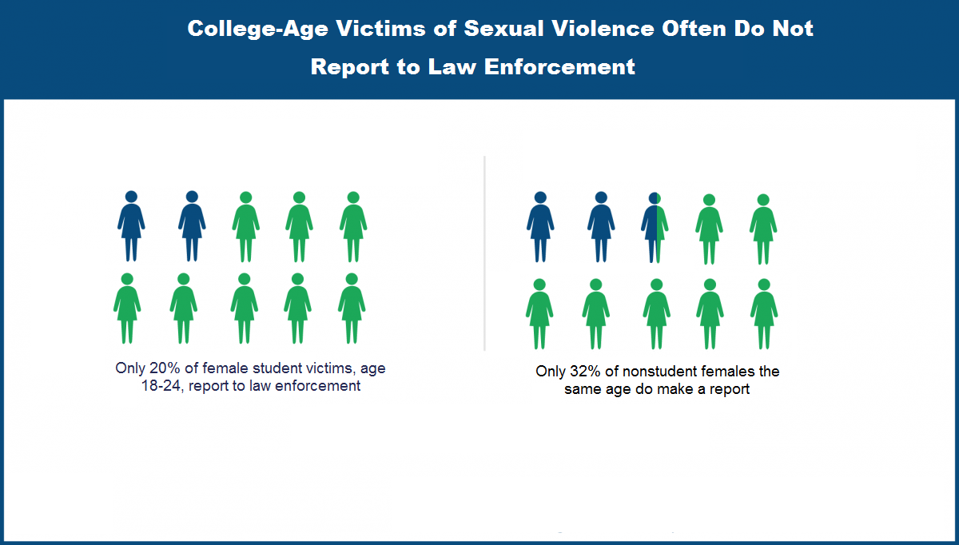
Comparison to national statistics: College-Age Victims of Sexual Violence Often Do Not Report to Law Enforcement

Slide 25
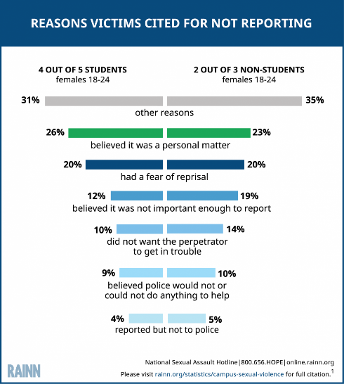
Comparison to national statistics: Reasons Victims Do Not Report to Law Enforcement

Slide 26
Recommendations:
Provide guidance to faculty and staff, students, and parents/guardians on how to respond when a student discloses sexual assault.
Thirteen Reasons Why clip
Work with the Student Counseling Center and Victim’s Advocates to offer guidance on how the investigative process can be better for involved parties.
With strict guidelines of not violating privacy rights
Inform students of services that are available for both victims and the accused (complainants and respondents).
We need to deliver a five star service of that offer
Notes:
If we are going to offer resources and services to students, we need to be sure to deliver excellent services and resources, and be consistent in our messaging.
When we talk about consent, we talk about the persons ability to consent; to give the enthusiastic and engaging YES! If a person, is incapacitated due to being under the influence of alcohol or drugs, they are not able to do this. Society often shames victims for being drunk when they were assaulted. Meaning, if they hadn’t been drinking they wouldn’t have been raped. It is important first responders and CSAs know how to respond when a student shares they were assaulted. The response from the person whom the victim trusted disclosing to, can effect the victim’s ability to move forward.
Although this is an important question to ask to determine a person’s ability to consent, the institution needs to move away from the shaming mentality. Just because a victim was drinking does not mean they were “asking for it” or that they were giving consent. Many professionals dismiss the validity behind the stories students tell about assault purely on the basis that they were intoxicated. Professional staff need to be trained on how to handle such situations to help the students not invalidate their experience. Although the series is controversial, the last episode in the series “Thirteen Reasons Why” shows how a staff member should NOT handle the situation when a student comes and reveals that they have been assaulted. Most people resonate with pop culture thus that would be a good clip to use to educate staff members.

Slide 27
Why do victims refrain from reporting?

Slide 28
They did not think the incident was serious enough to report.

Slide 29
They didn’t know how to contact the resources.

Slide 30
They felt that other people might think that what happened was at least partly their fault or that they might get in trouble.

Slide 31
They felt that they were concerned they’d be treated poorly or that no action would be taken.

Slide 32
They were concerned the groups notified would not keep their situation confidential.

Slide 33
They were worried that either the person who did this to them or other people might find out and do something to get back at them.

Slide 34
Recommendations
Address the mindset
Breakdown the policies more in social media initiatives
Includes other misconduct beyond rape
The Hunting Ground
Film viewing and intentional discussion
SMRT Panel

Slide 35
Next Steps
Sexual Misconduct Response Team
Develop a strategic plan for Title IX education, prevention, and resources. Use the IOB coalition to move it forward.
Develop guidance for sexual misconduct programming
Track campus wide programming and education on sexual misconduct
Develop an It’s On Blue Campus and Community Coalition
Focus: Education on Title IX, prevention programming, provide guidance on sexual misconduct programming to other groups.
Student orgs. will send a representative to serve on the coalition and be the liaison for their respective groups.
Be a standing partner for events, possibly provide grants for programming

Slide 36
Next Steps- continued
Bystander Intervention Curriculum
Develop curriculum covering general Title IX and bystander intervention education (Step Up, One Love, general Title IX) and present to all incoming students through partnering with University Colleges.
Explore other programs: Not Any More (Every Choice and GreenDot by Student Success)
Partner with Multi-cultural Services and Programs to create presentations and resources for “The Forgotten Populations.”
Explore educational toolkits for individuals held responsible for Title IX violations

Slide 37
Thank you

